Slide 1


Eco-systems mapping of Continental’s Strategic Domains

Slide 2

Table of content
Context & key objectives 03
Methodological note 07
Technological profiles of the strategic domains 11
Worldwide urban ecosystems 30
Key organizations & inventors 55
Key organizations & inventors in urban ecosystems 72
Interactive material & data 91

Slide 3
Context & key objectives

Slide 4
The three pillars of corporate innovation strategy
What technology should be prioritized?
WHAT ?
Innovation Strategy
Where to locate innovation activities?
Who to connect with?
WHERE?
WHO ?
4
5

Slide 5
From strategic challenges to data solutions
WHAT?
WHERE?
WHO?
Strategic
challenge
What technology should be prioritized?
Where to locate innovation activities?
Who to connect with?
Level of
analysis
Technological ecosystems
Urban ecosystems
Actor ecosystems
Actor ecosystems
Key
metrics
Classification Velocity Relatedness
Patent counts Relatedness density Comp. Advantages
Patent counts Patent shares
Patent counts
Patent shares
Business
decisions
R&D investments
Tech diversification
New use cases
Spatial scouting
Set-up incubators
Locate R&D labs
Collaborations
M&As
Talent acquisitions
5

Slide 6
Key objective
The key objective is to support Continental’s innovation efforts by mapping worldwide eco-systems in 8 strategic domains: head-up displays, computer-aided design, optical systems (general), holography, screen displays (vehicules), optical components, arrangement for software engineering & Automotive ECUs.
1
Define the technological profiles of these domains
2
Map worldwide knowledge eco-systems in these domains
3
Identify the key actors in these domains
6

Slide 7
Methodological note

Slide 8
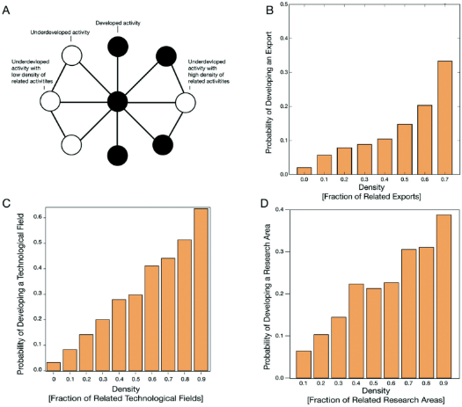
Academic framework of economic complexity
Economic complexity principles are used to define the technological profiles of the different domains and identify knowledge hubs.
The literature on economic complexity applies network science, big data, and machine learning to understand economic development. One of the key finding of this literature is that corporate and regional diversification happens through the principle of relatedness.
Inventors, companies and regions develop new products and technologies by recombining pre-existing available capabilities. Mapping existing capabilities allows to estimate the distance with any new domain – measured by the concept of relatedness. (see figure 3A). The higher the degree of relatedness between an entity and a new economic activity, the higher the probability of diversification (see figure 3B;3C;3D).
To draw the maps presented in this report, we produce 3 indicators: number of patents, relatedness density and relative comparative advantages. All formulas can be found in Hidalgo, Balland et al. (2020). The location index that we present combines rankings in terms of patent quantity in a given domain + relative specialization & relatedness density (urban profile).
Figure 3. The principle of relatedness
Hidalgo, Balland et al. (2020)
Unifying Themes in Complex Systems
8
5

Slide 9
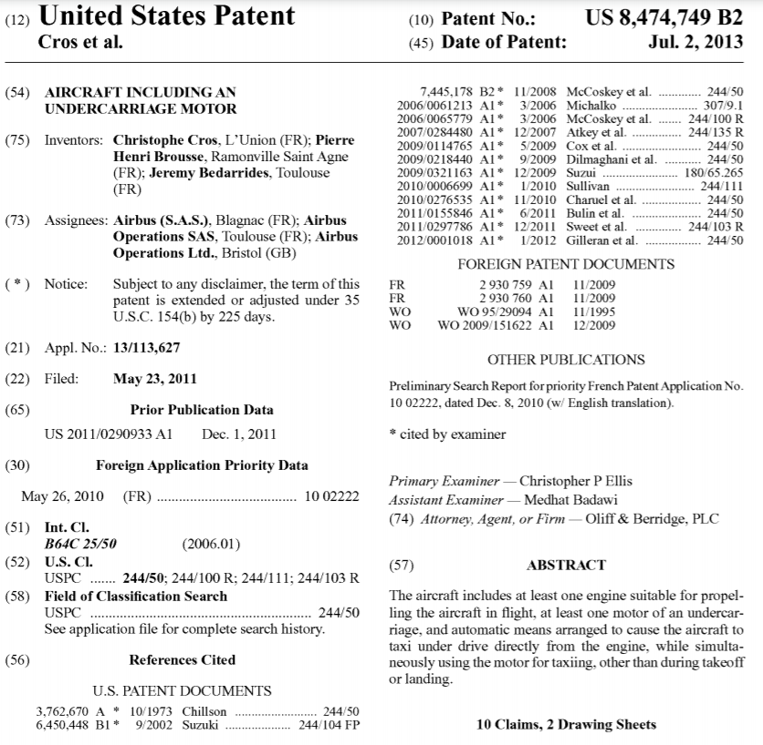
Analysis of large patent datasets
Publication date
Precise geolocation of the place of knowledge production based on inventors home adresses
Citations to other patents
Application date
Citation to non-patent literature (scientific publications, reports)
Specific classification in one of the 250,000 different technological category
Summary +
complete text
The data source used in this analysis is the OECD REGPAT – 2022 edition
9
5

Slide 10

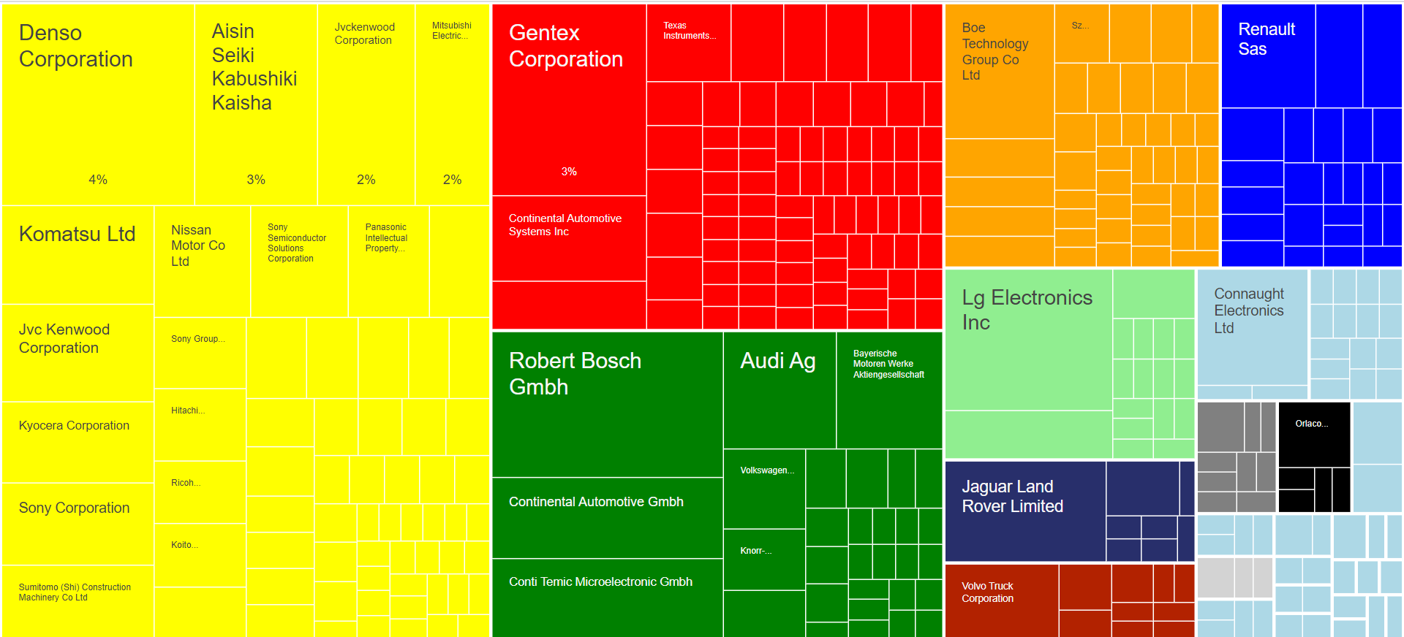
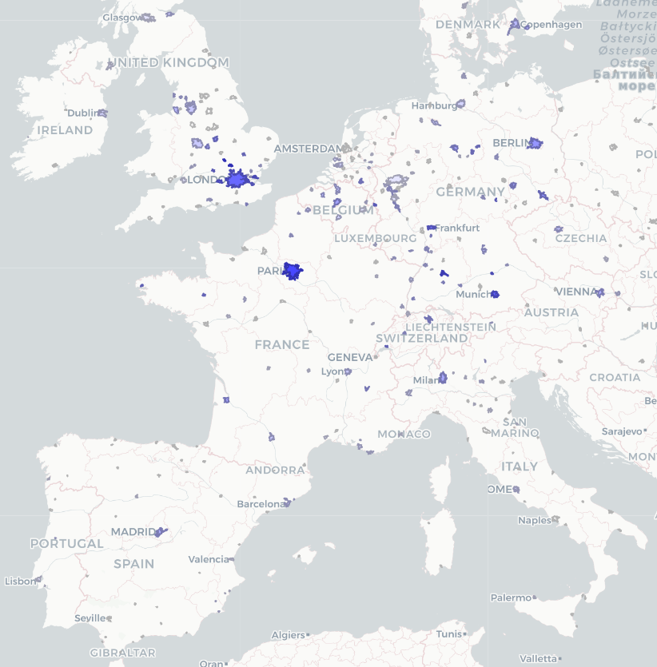
High-end interactive data visualizations tools
Key information for strategy decision making are made available through high-end interactive data visualizations tools (HTML). Links to the interactive material are launched by
Share of patents produced by a given company/inventor – top candidates for strategic collaborations & hiring
Urban ecosystems with the highest relatedness density, relative comparative advantage and patent counts – top candidates for location choices
10
5

Slide 11
Technological profiles of
the 8 domains

Slide 12
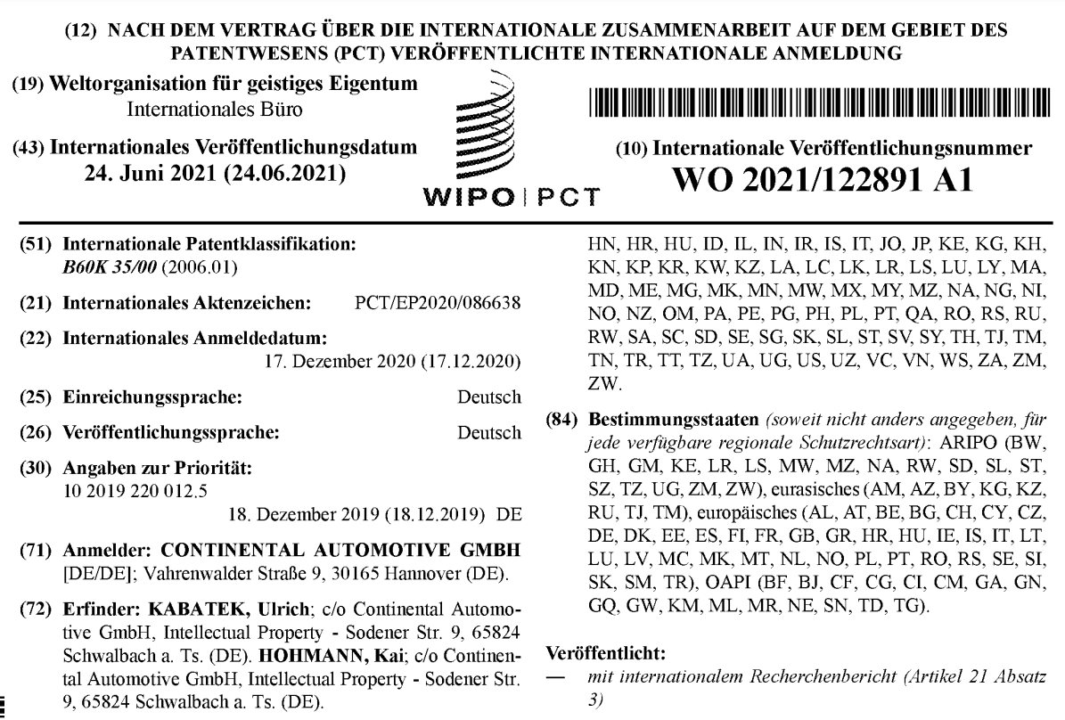

Classification of patents in strategic domains
We use a text mining algorithm to identify the patents that corresponds to the 8 strategic domains of head-up displays, computer-aided design, optical systems (general), holography, screen displays (vehicules), optical components, arrangement for software engineering & Automotive ECUs.
First, Continental experts & Argos delineate the technological landscape and set up a list of key words that characterize the different strategic domains.
Second, a text mining algorithm searches these key words and their specific association in the text of patent documents as well as in the Cooperative Patent Classification (CPC) nomenclature. The CPC nomenclature is developed and maintained by the European Patent Office (EPO) and the US Patent and Trademark Office.
The algorithm returns a list the specific technological classes are most frequently associated with these key words. For ‘Screen displays (vehicules)’ for instance, the algorithm returns the class B60K2370/152.
In a third step, all the CPC classes associated by the algorithm with the 8 strategic domains are manually checked by Continental experts & Argos.
12
5

Slide 13
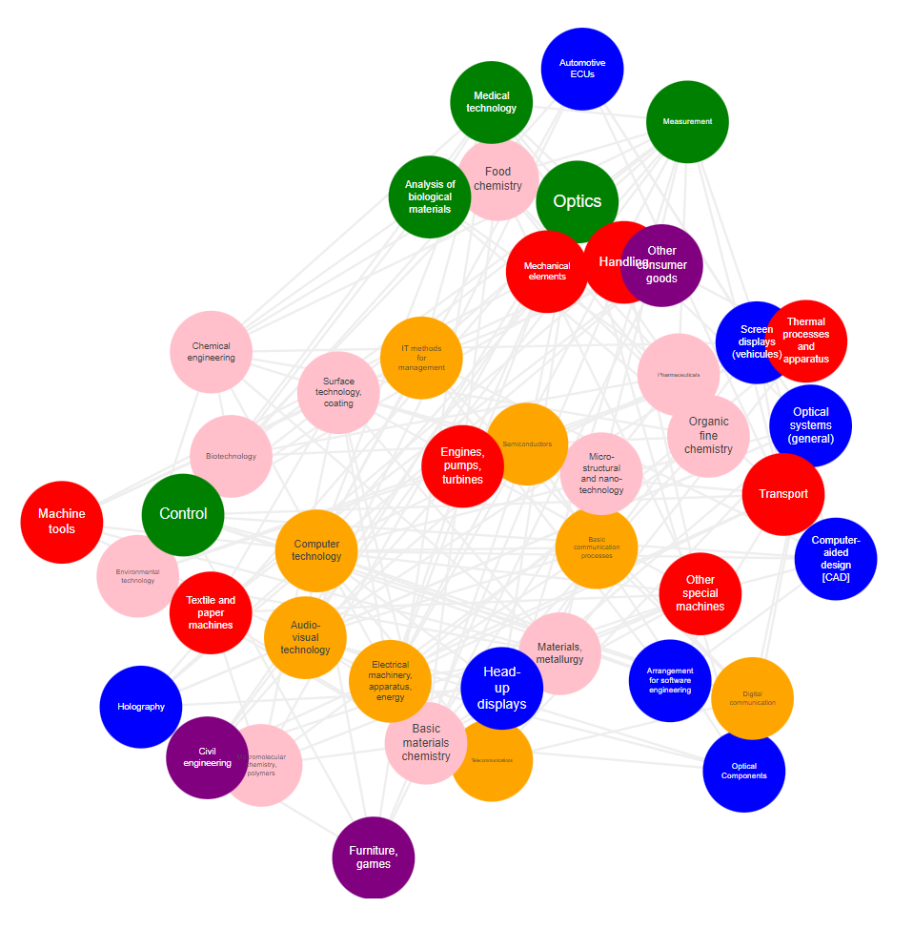
Technology space and relatedness measure
The technology space is a representation of the technological links between the different strategic domains (relatedness).
Elements of the TS represent different (sub-) strategic domains and links between them represents their degree of relatedness. Automotive ECUs, for instance, builds on diverse domains such as transport, computers, and audio-visual technology.
The degree of relatedness is measured in 2 steps:
- Count of co-occurrences of 2 domains in the same patent
- Normalization of theses cooccurrences using the cosine index
The exploration of the technology space allows to understand the links between technologies and the way knowledge recombines into new inventions.
Relatedness metrics are the building blocks of recommendation systems predicting new location hubs or company’s diversification potential in different domains. The TS we use for this project is therefore not limited to the 8 domains but includes all technological classes of the CPC nomenclature.
13
5

Slide 14
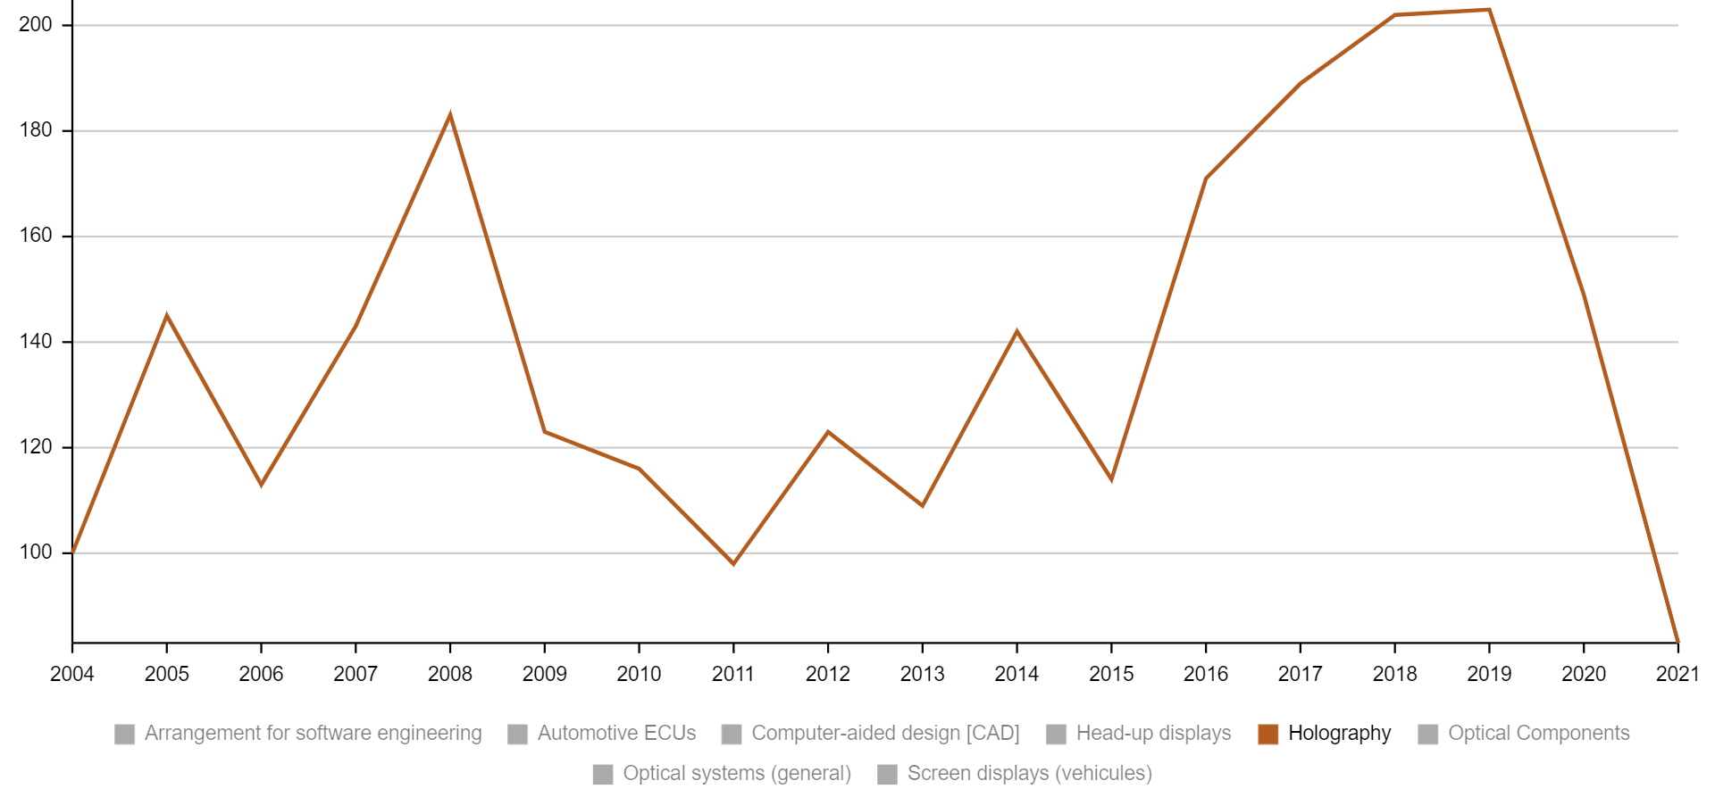
Velocity – Holography
+103%
14
5

Slide 15
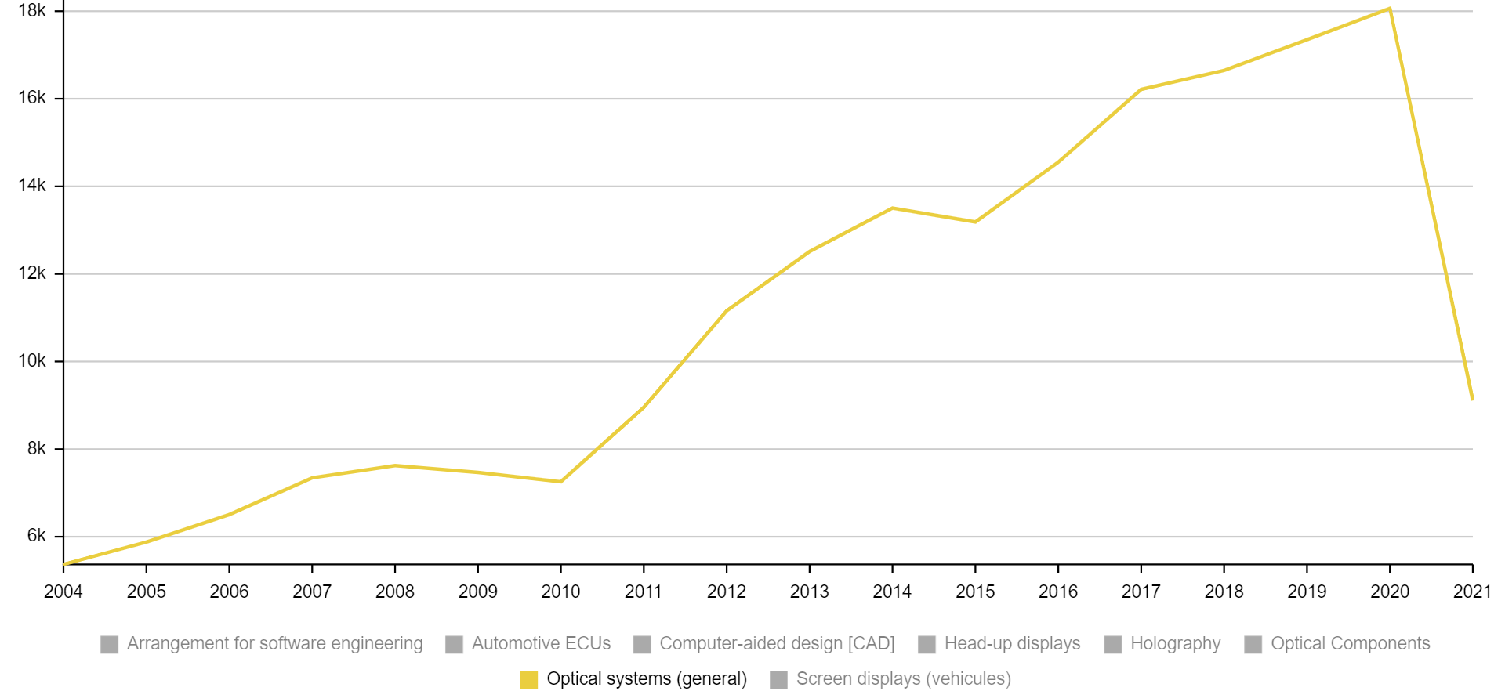
Velocity – Optical systems (general)
+236%
15
5

Slide 16
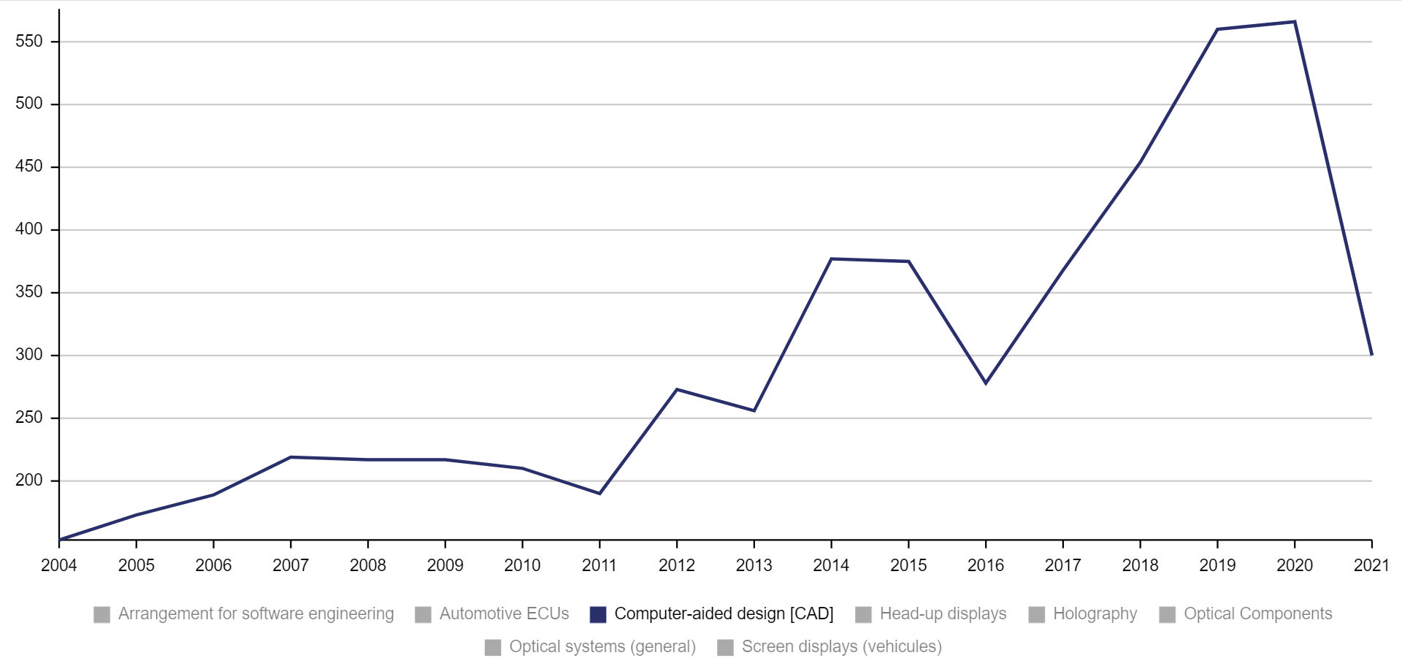
Velocity – Computer-aided design (CAD)
+269%
16
5

Slide 17
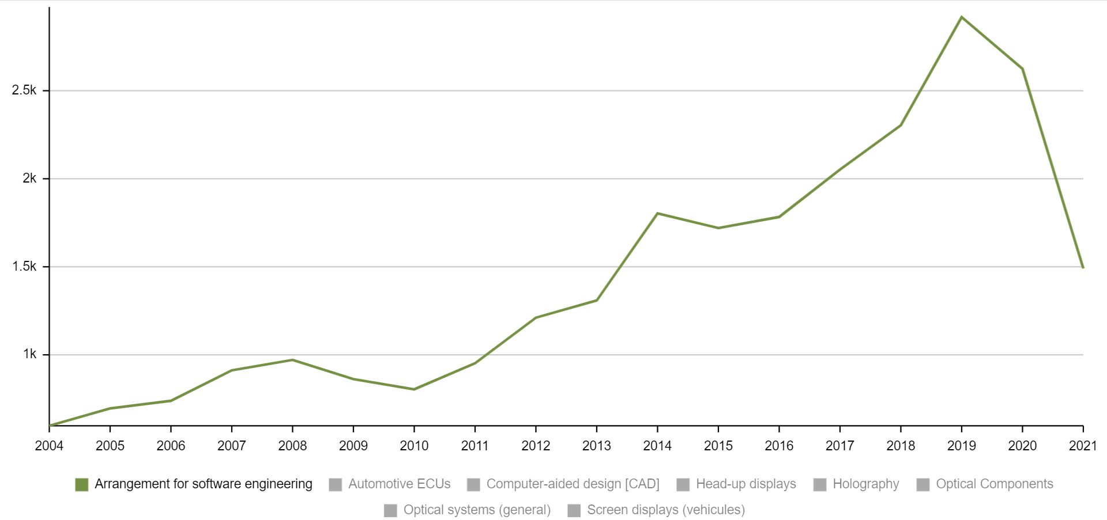
Velocity – Arrangement for software engineering
+388%
17
5

Slide 18
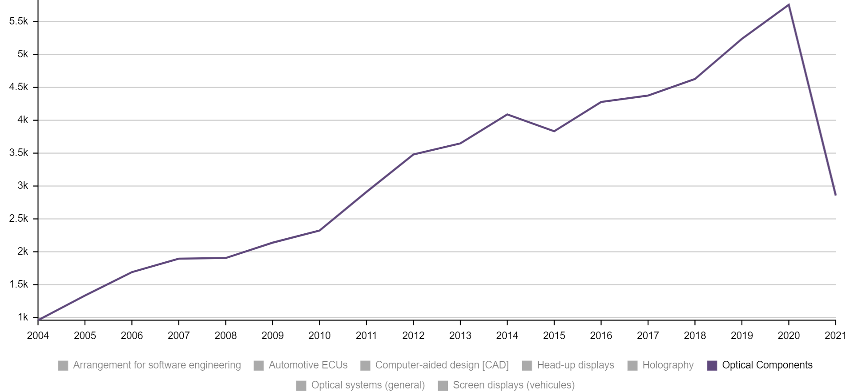
Velocity – Optical components
+499%
18
5

Slide 19
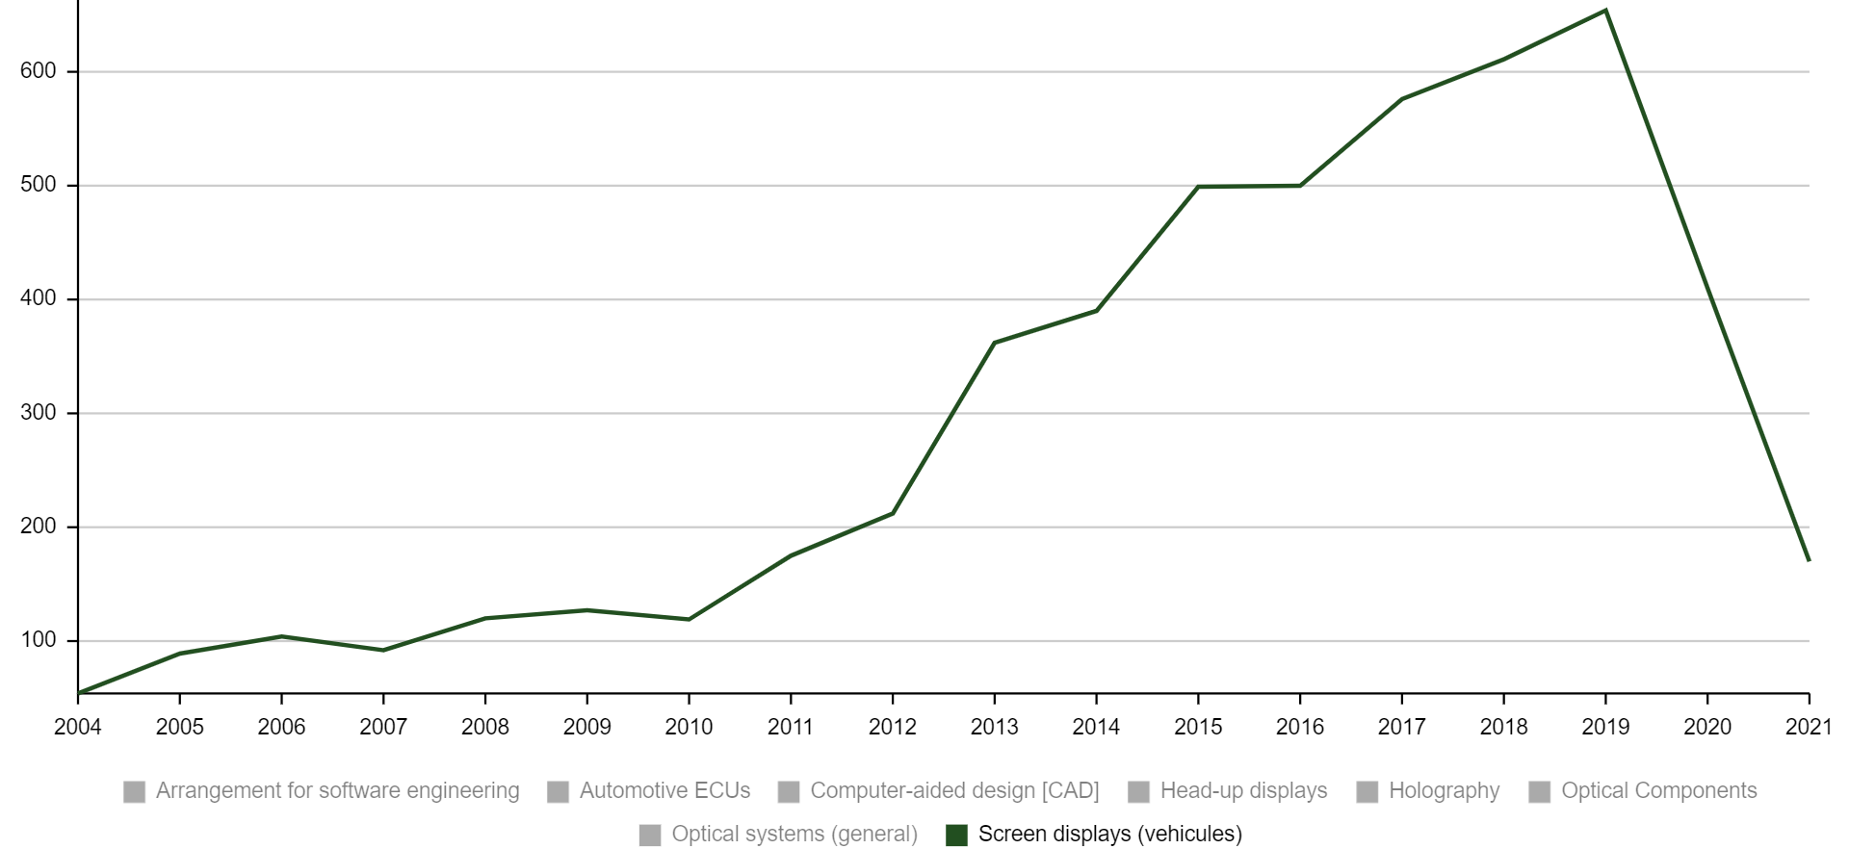
Velocity – Screen displays (vehicules)
+1111%
19
5

Slide 20
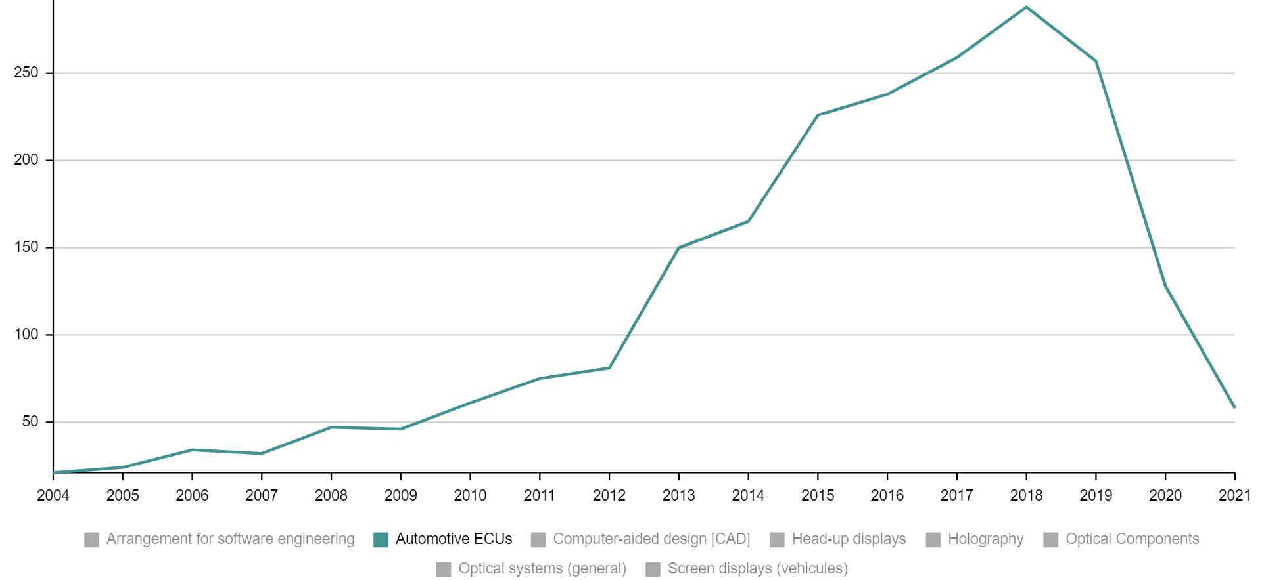
Velocity – Automotive ECUs
+1271%
20
5

Slide 21
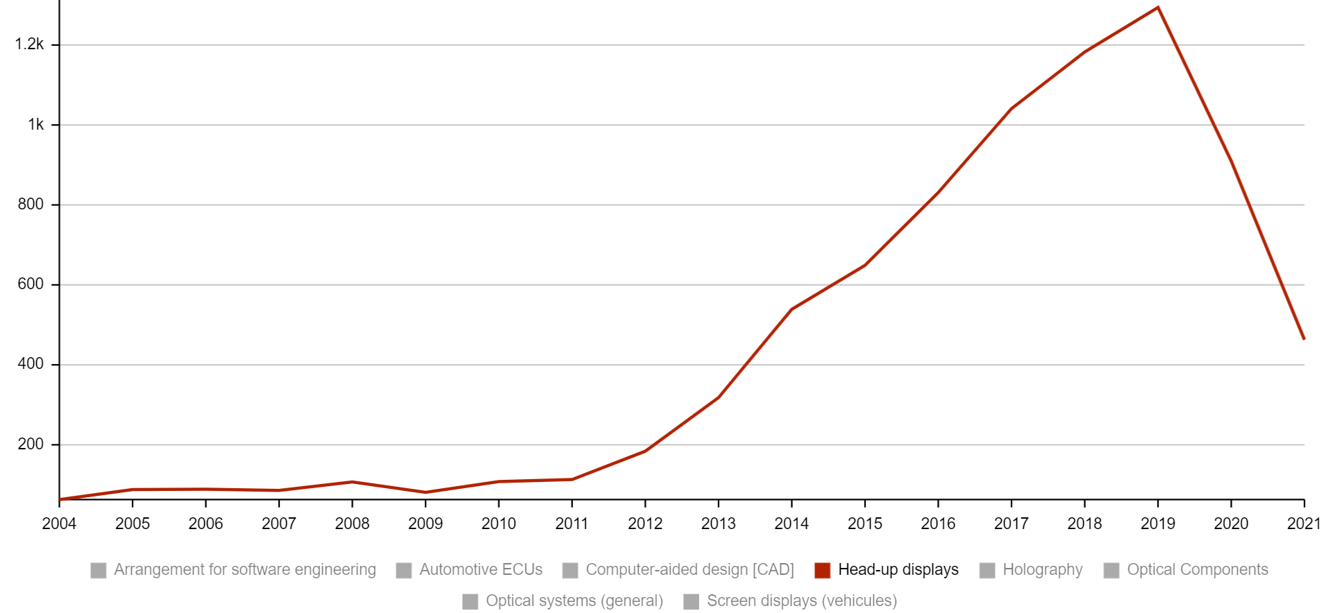
Velocity – HUD
+1953%
21
5

Slide 22
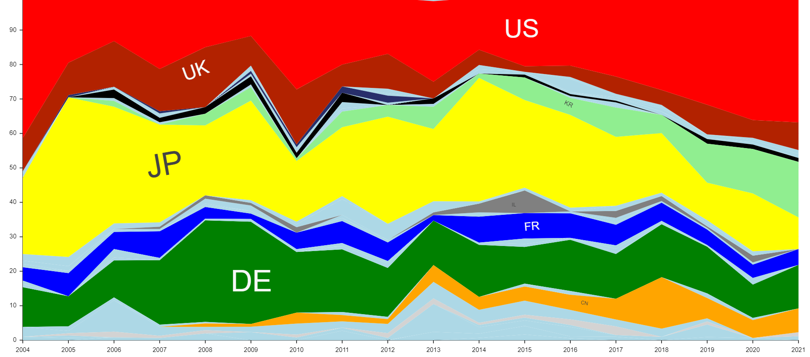
Velocity per country – Holography
22
5

Slide 23
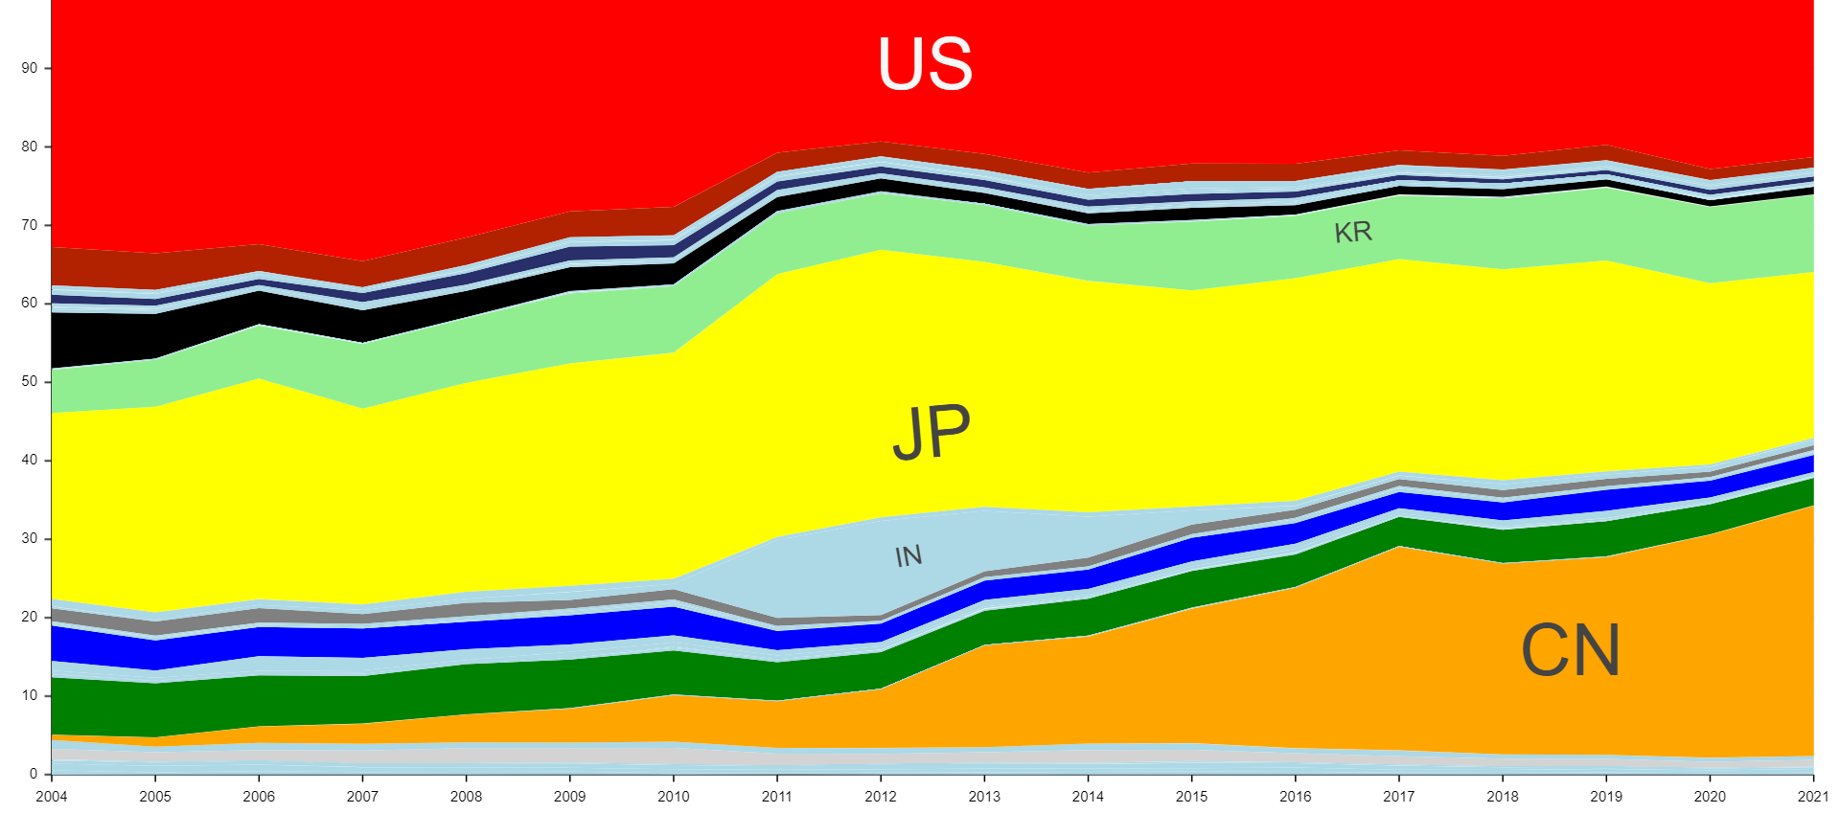
Velocity per country – Optical systems (general)
23
5

Slide 24
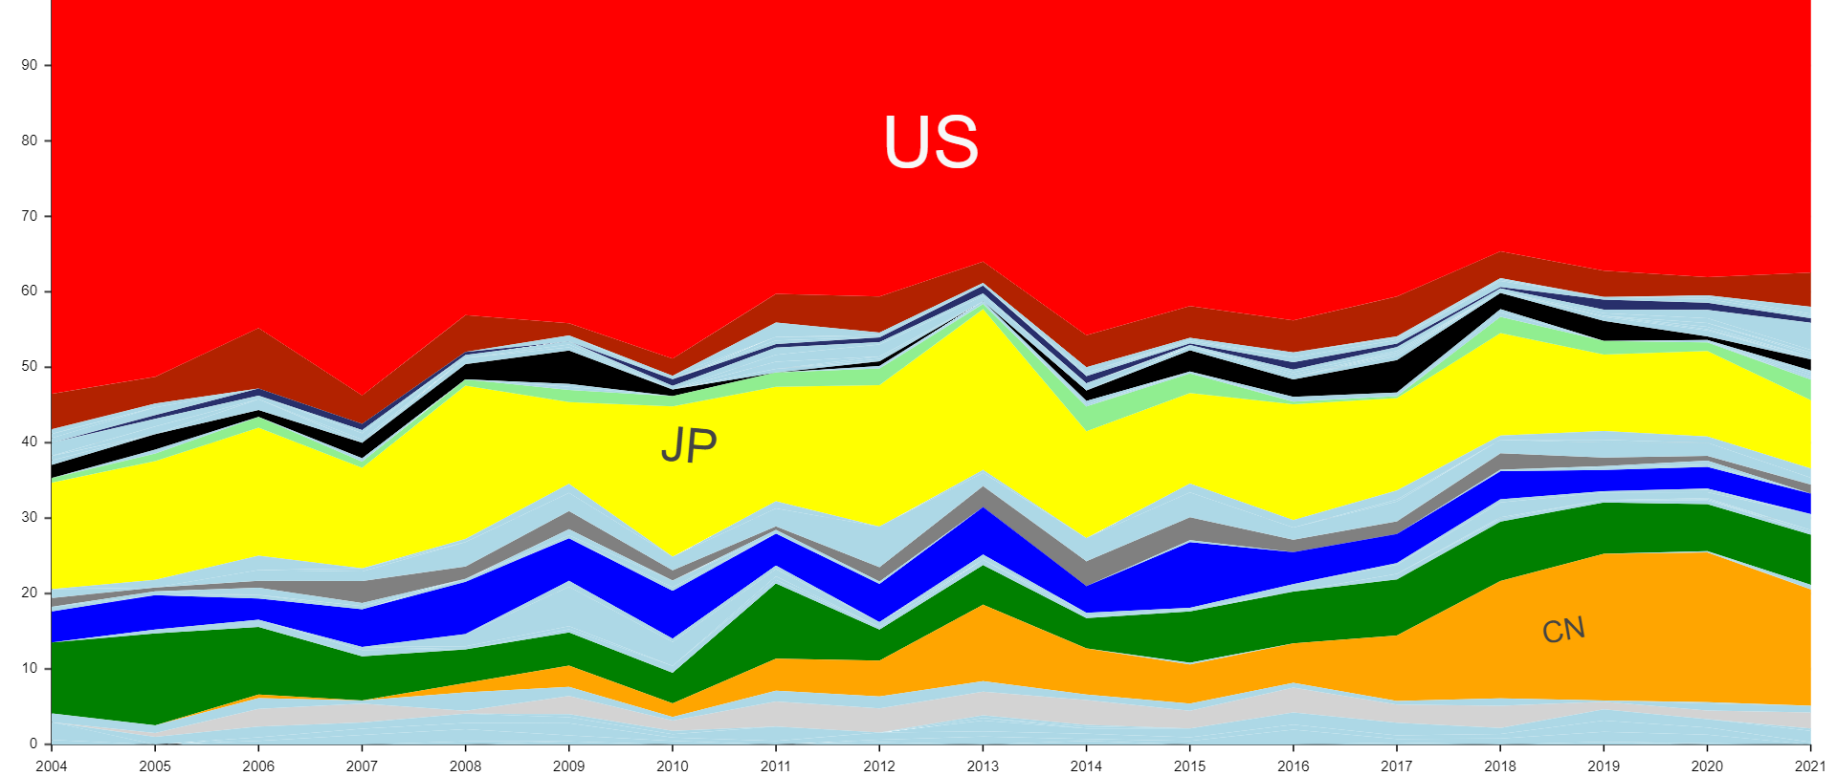
Velocity per country – CAD
24
5

Slide 25
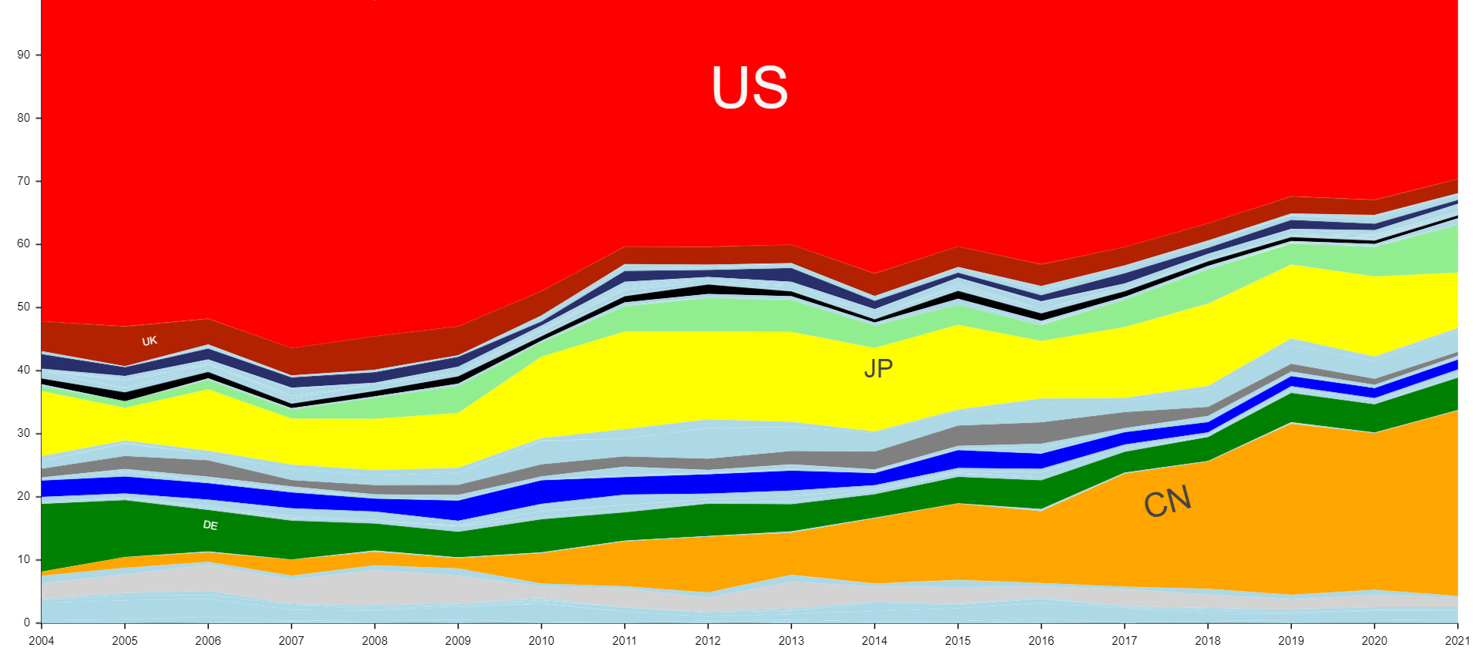
Velocity per country – Arrangements for SE
25
5

Slide 26
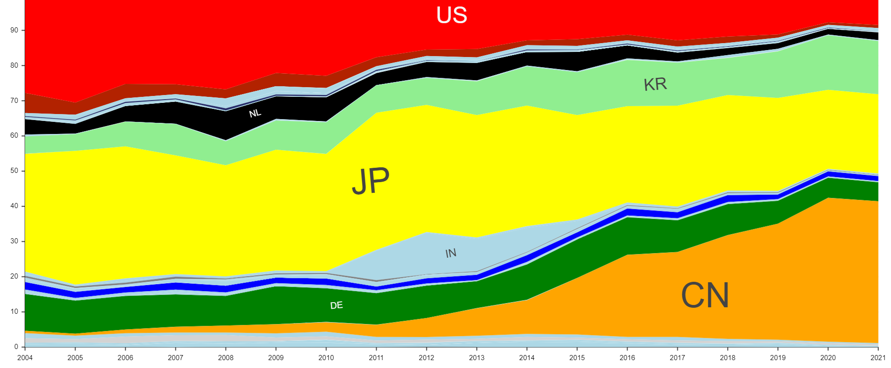
Velocity per country – Optical components
26
5

Slide 27
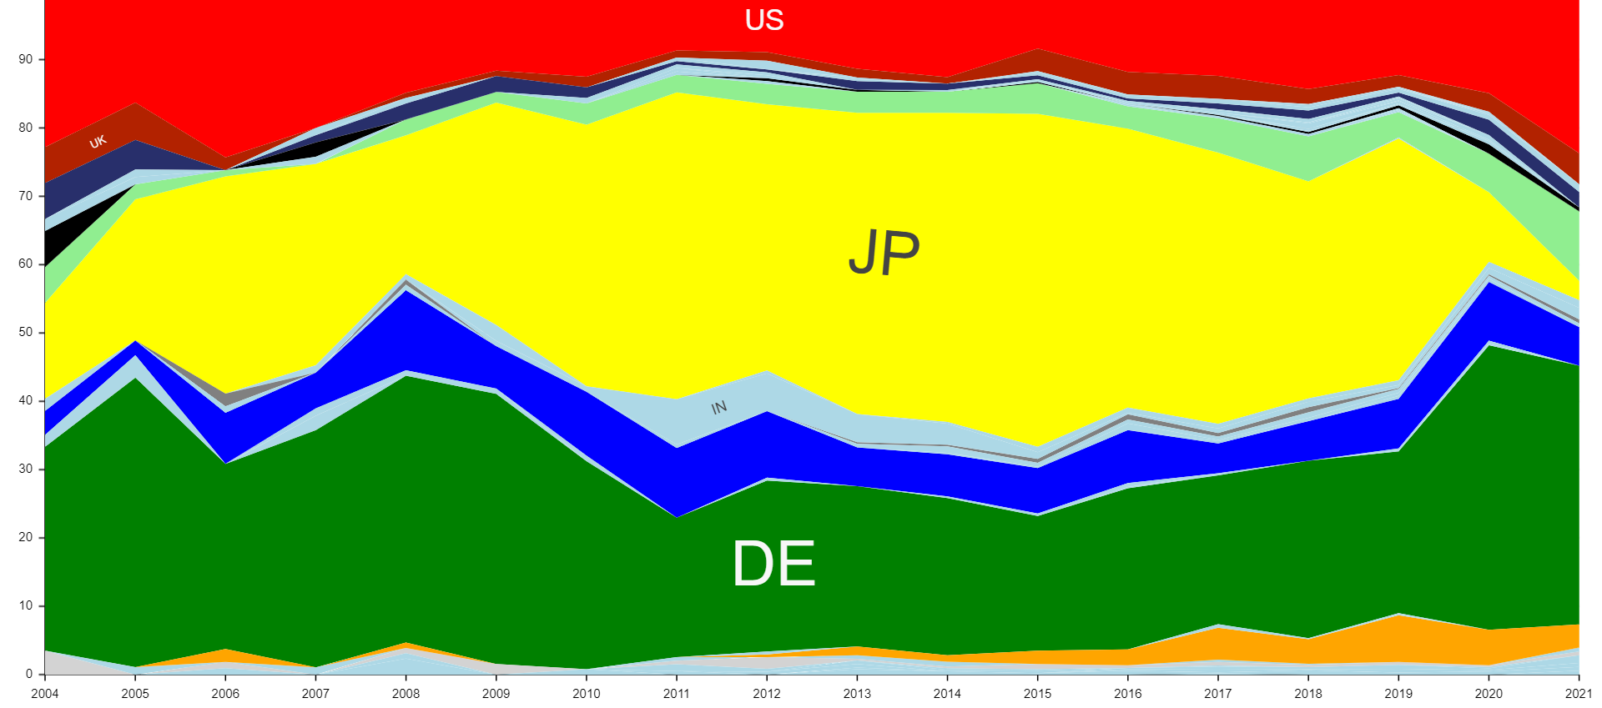
Velocity per country – Screen displays (vehicules)
27
5

Slide 28
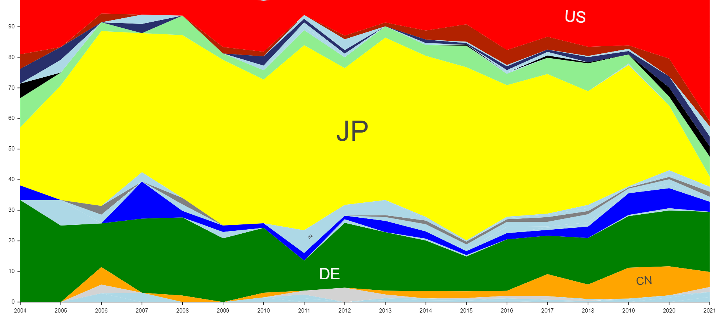
Velocity per country – Automotive ECUs
28
5

Slide 29
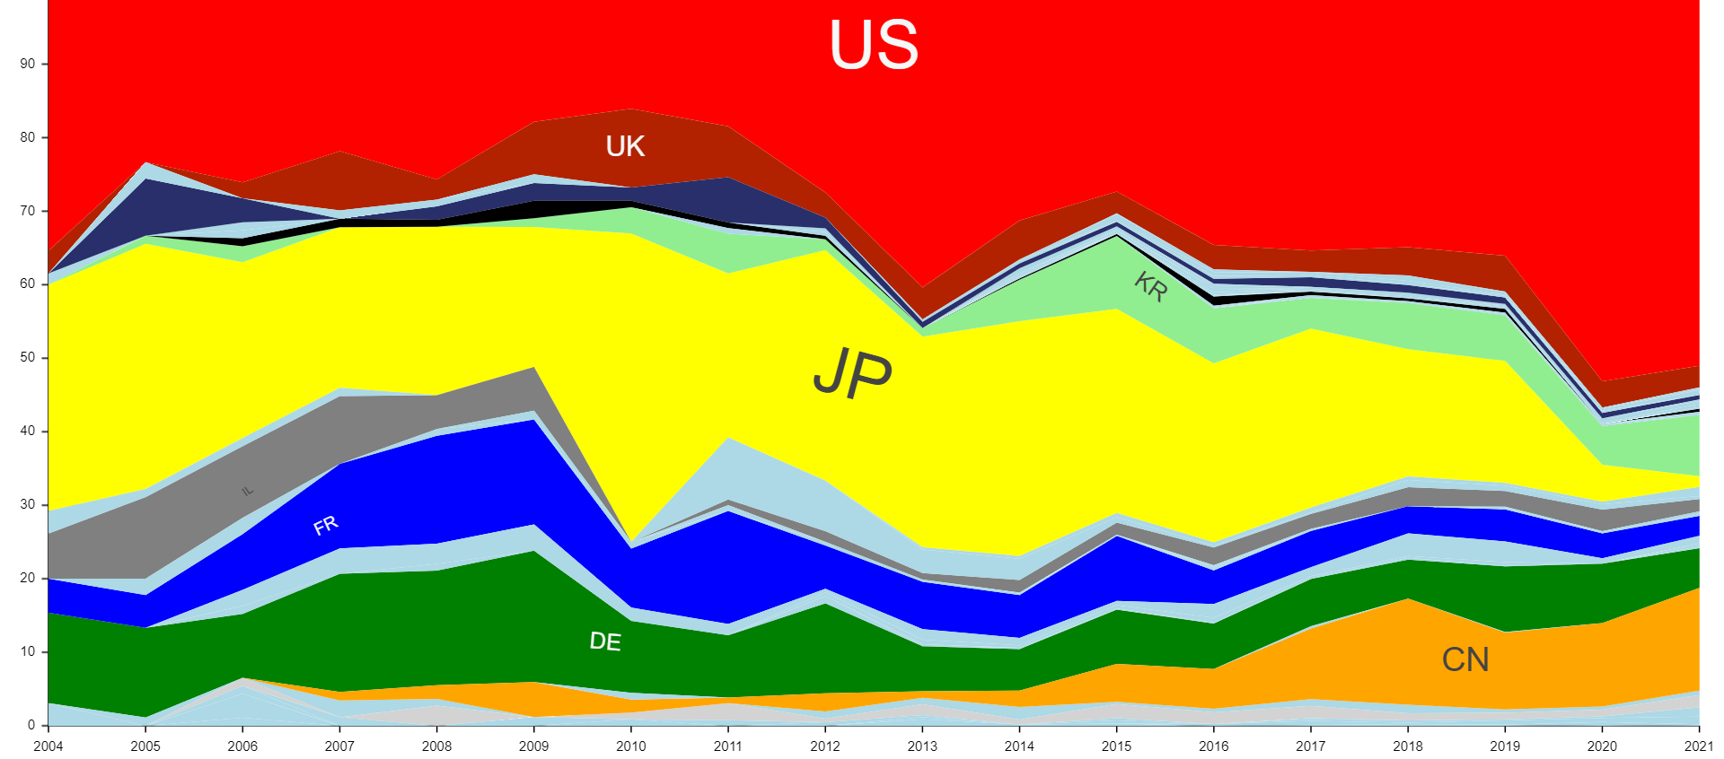
Velocity per country – HUD
29
5

Slide 30
World urban ecosystems

Slide 31
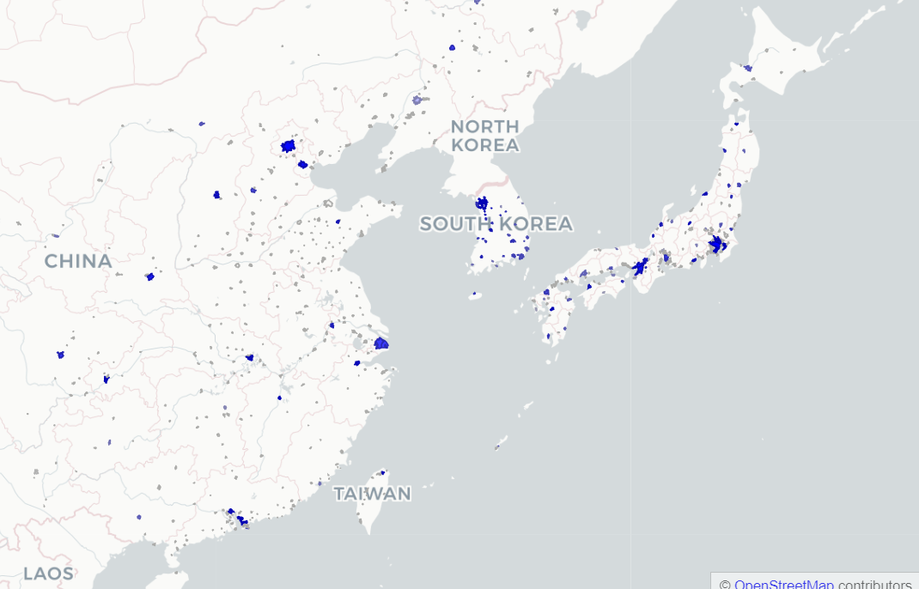
East Asia - Holography
Beijing (#13)
Seoul (#12)
Tokyo (#18)
Kyoto (#35)
Daejeon (#40)
31

Slide 32
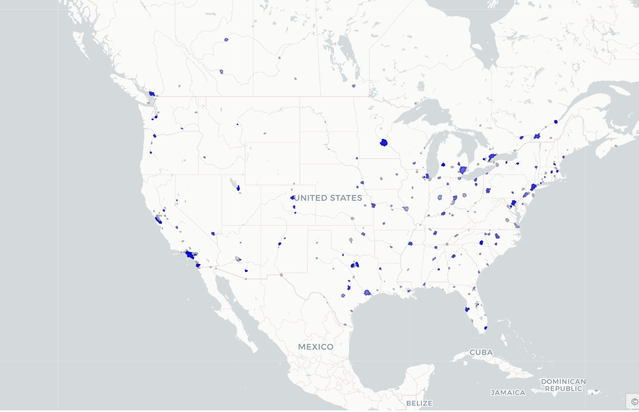
North America - Holography
Seattle (#3)
Denver (#21)
San José - SF (#2)
Los Angeles (#4)
Tucson (#6)
32

Slide 33
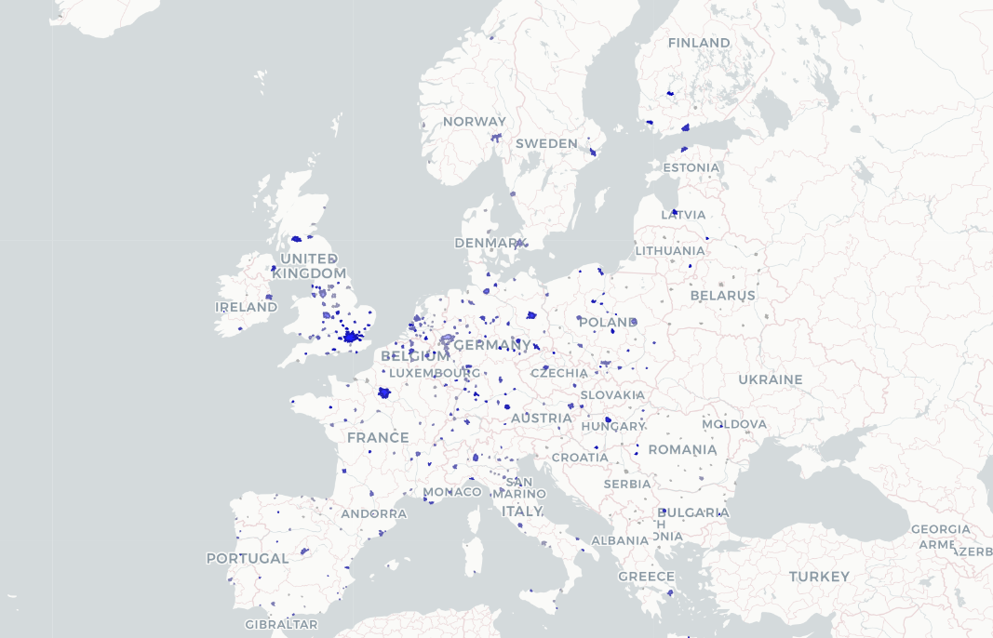
Europe - Holography
Milton Keynes (#8)
Dresden (#1)
Jena (#5)
Rennes (#10)
Stuttgart (#10)
Grenoble (#10)
33

Slide 34
East Asia – Optical systems
Beijing (#2)
Seoul (#2)
Tokyo (#1)
Hangzhou (#7)
Shenzhen (#4)
34

Slide 35
North America – Optical systems
Seattle (#11)
San José - SF (#5)
Rochester NY (#13)
Los Angeles (#6)
Miami (#18)
35

Slide 36
Europe – Optical systems
Tempere (#15)
Eindhoven (#31)
Aachen (#28)
Jena (#17)
Rennes (#10)
Tel Aviv (#22)
36

Slide 37
East Asia – CAD
Shenyang (#5)
Beijing (#29)
Tokyo (#34)
Nanjing (#10)
Shanghai (#20)
Bangalore (#14)
Mumbai (#18)
37

Slide 38
North America – CAD
Albany NY (#2)
Portland (#3)
New York (#4)
San José - SF (#1)
Austin (#6)
38

Slide 39
Europe – CAD
Cambridge (#7)
London (#16)
s' Gravenhage (#23)
Munich (#8)
Barcelona (#28)
Tel Aviv (#12)
Haifa (#14)
39

Slide 40
East Asia – Arrangements for SE
Beijing (#10)
Seoul (#26)
Hangzhou (#6)
Shenzhen (#4)
Bangalore (#5)
Mumbai (#12)
Singapore (#19)
40

Slide 41
North America – Arrangements for SE
Seattle (#1)
New York (#9)
San José - SF (#2)
Washington (#3)
Fayetteville (#7)
41

Slide 42
Europe – Arrangements for SE
Cambridge (#48)
Dublin (#38)
Moscow (#36)
London (#16)
Cardiff (#32)
Munich (#32)
Tel Aviv (#8)
42

Slide 43
East Asia – Optical components
Seoul (#3)
Tokyo (#5)
Shiga (#6)
Chungcheongnam-do (#4)
Wuhan (#1)
43

Slide 44
North America – Optical components
Portland (#48)
Syracuse NY (#40)
San José - SF (#32)
Albany NY (#37)
Albuquerque (#50)
44

Slide 45
Europe – Optical components
Aachen (#13)
Darmstadt (#8)
Frankfurt (#18)
Regensburg (#2)
Grenoble (#16)
45

Slide 46
East Asia – Screen displays (vehicules)
Niigata (#12)
Tokyo (#14)
Aichi (#4)
Kyoto (#17)
Hiroshima (#18)
46

Slide 47
North America - Screen displays (vehicules)
Grand rapids (#6)
Detroit (#8)
San José - SF (#43)
Rochester NY (#13)
Dayton (#50)
47

Slide 48
Europe - Screen displays (vehicules)
Hannover (#9)
Coventry (#7)
Stuttgart (#6)
Paris (#10)
Ingolstadt (#1)
Munich (#4)
48

Slide 49
East Asia – Automotive ECUs
Seoul (#20)
Tokyo (8)
Aichi (#2)
Kyoto (#21)
Hiroshima (#12)
49

Slide 50
North America – Automotive ECUs
Seattle (#50)
Grand rapids (#1)
Detroit (#3)
San José - SF (#28)
Los Angeles (#48)
50

Slide 51
Europe – Automotive ECUs
Coventry (#6)
West IE (#5)
Stuttgart (#4)
Ingolstadt (#8)
Munich (#9)
51

Slide 52
East-Asia - Head-up displays
Beijing (#12)
Seoul (#12)
Niigata (#7)
Tokyo (#10)
Kyoto (#18)
52

Slide 53
North-America - Head-up displays
Seattle (#2)
San José - SF (#3)
Rochester NY (#9)
Los Angeles (#13)
Miami (#1)
53

Slide 54
Europe - Head-up displays
Tempere (#7)
Medway (#7)
Jena (#14)
Stuttgart (#15)
Ingolstadt (#5)
Tel Aviv (#4)
54

Slide 55
Key organizations & inventors

Slide 56
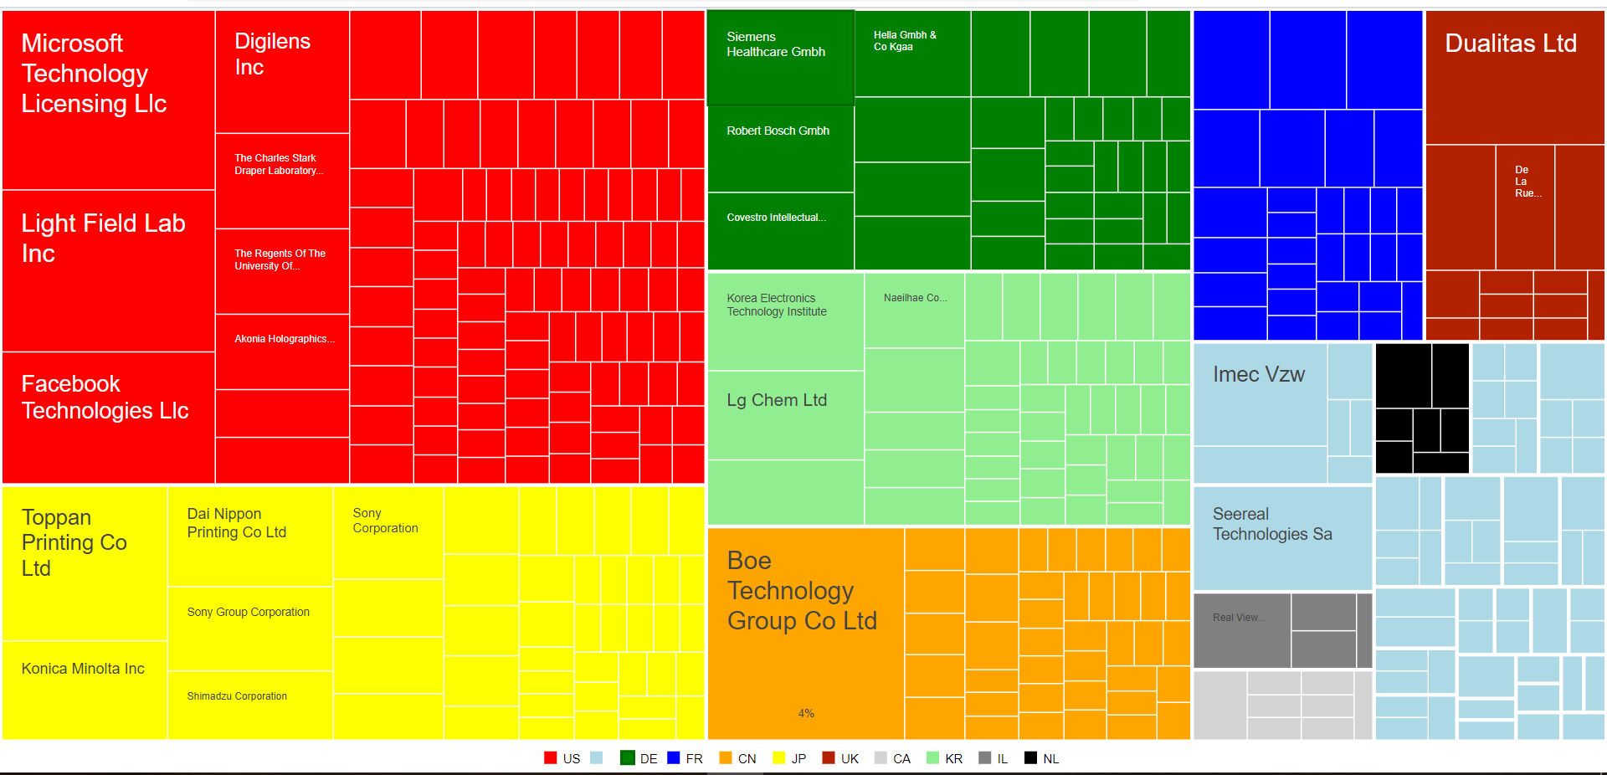
Applicants – Holography
56
5

Slide 57
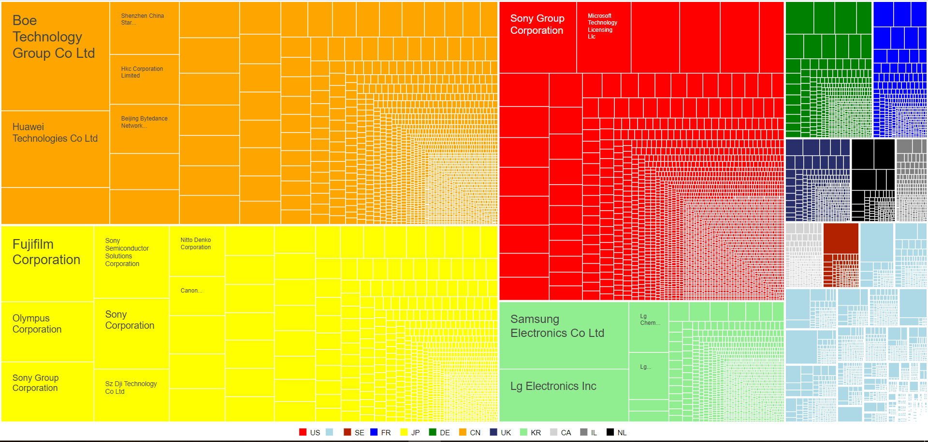
Applicants – Optical systems (general)
57
5

Slide 58
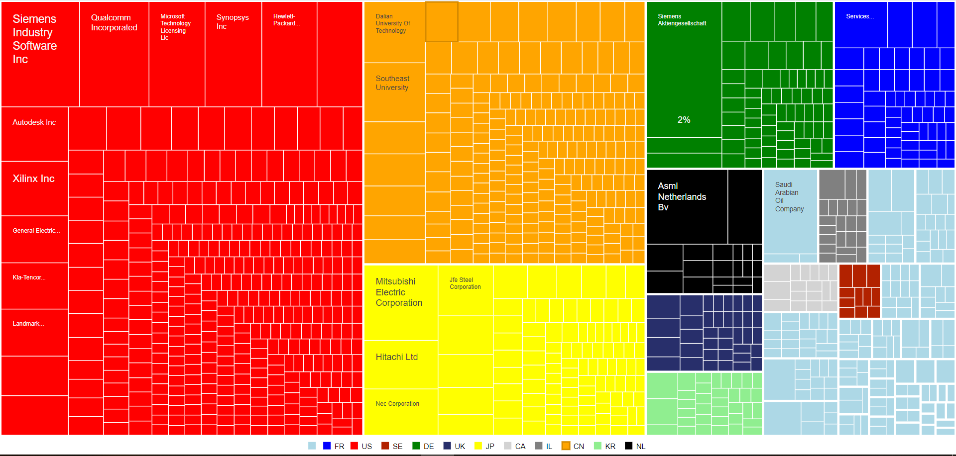
Applicants – CAD
58
5

Slide 59
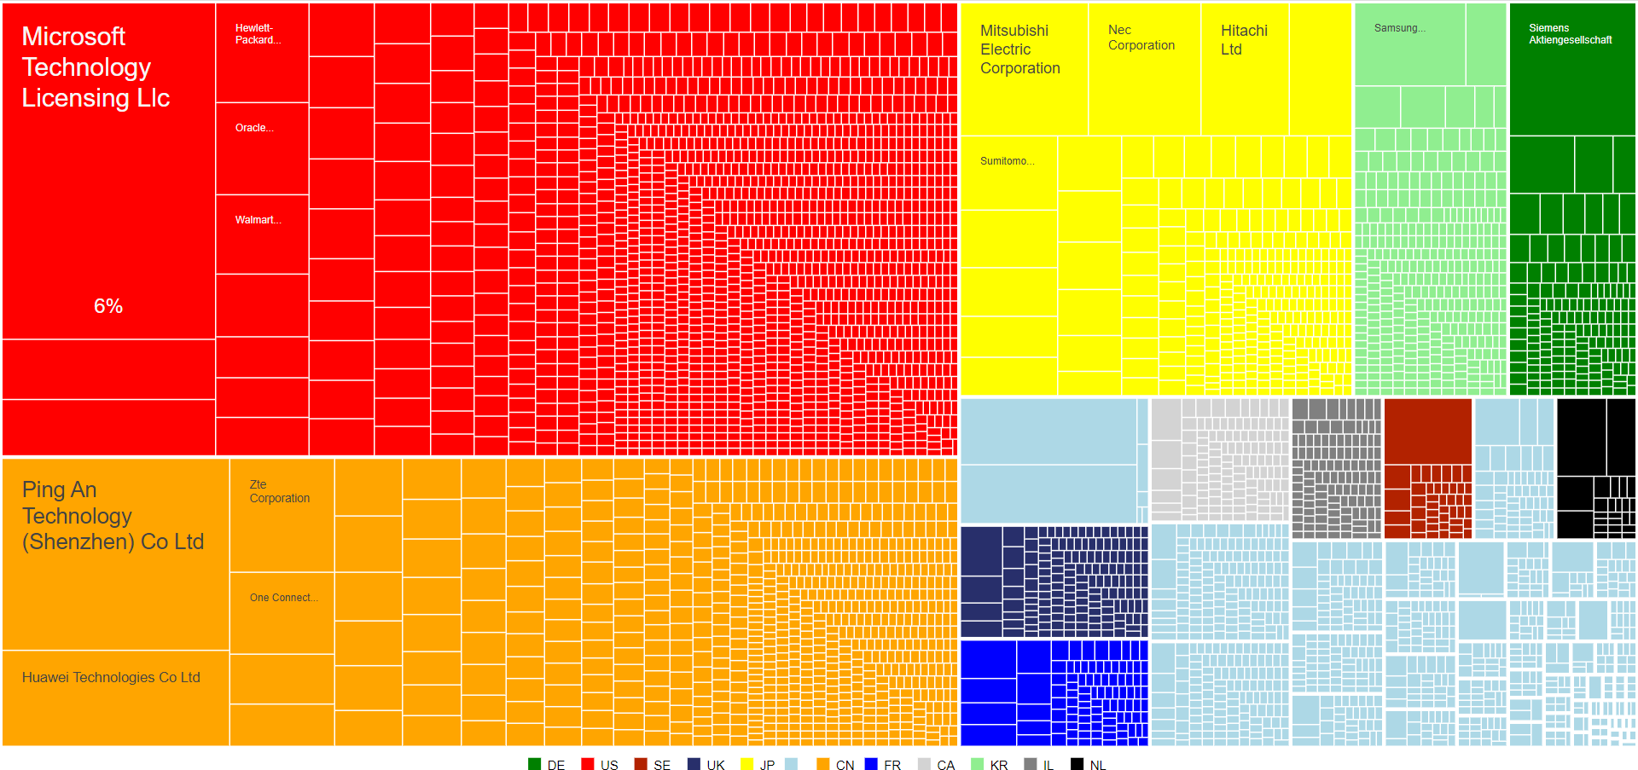
Applicants – Arrangements for SE
59
5

Slide 60
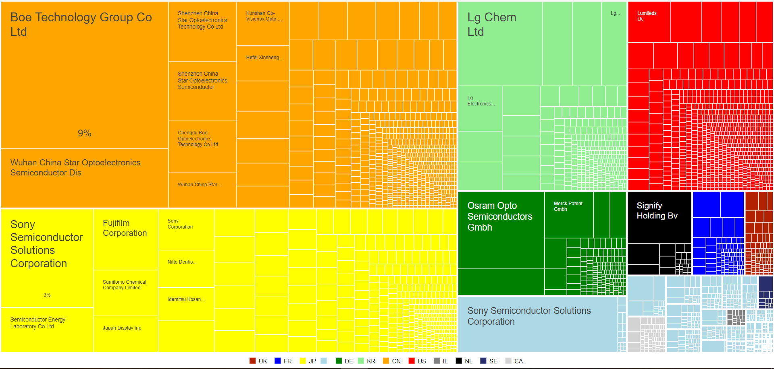
Applicants – Optical components
60
5

Slide 61
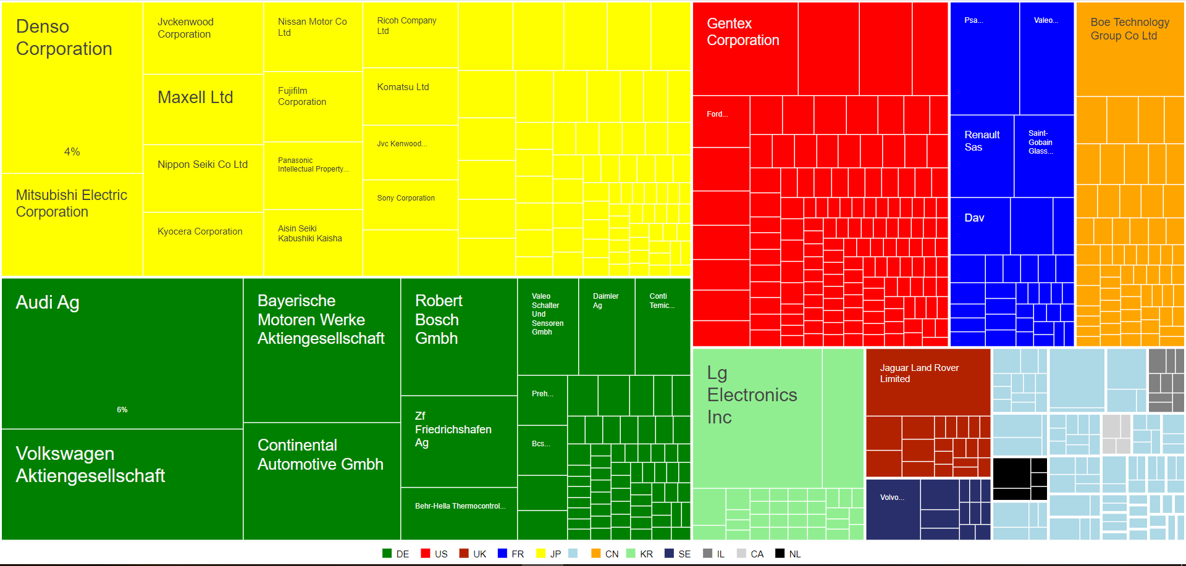
Applicants – Screen displays (vehicules)
61
5

Slide 62

Applicants – Automotive ECUs
62
5

Slide 63
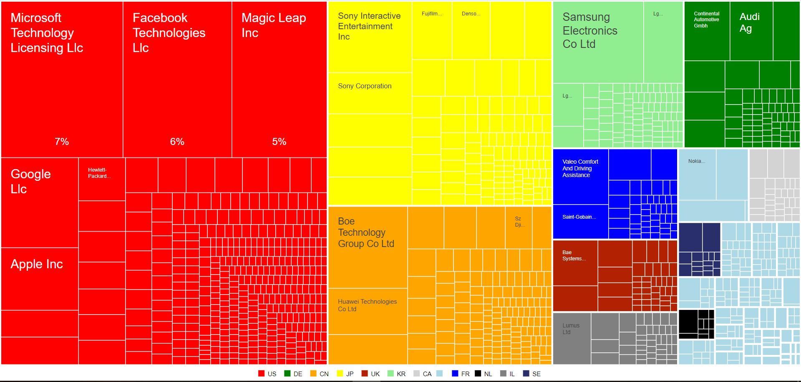
Applicants – HUD
63
5

Slide 64
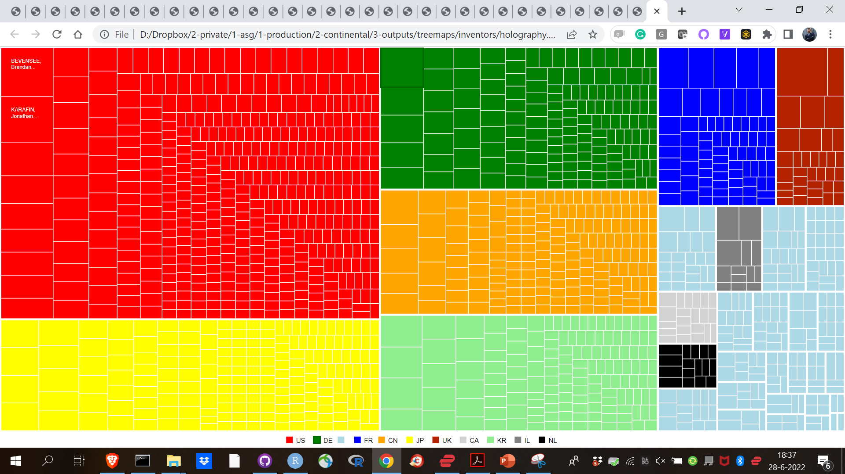
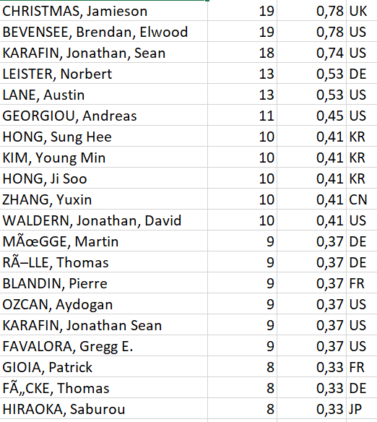
Inventors – Holography
64
5

Slide 65
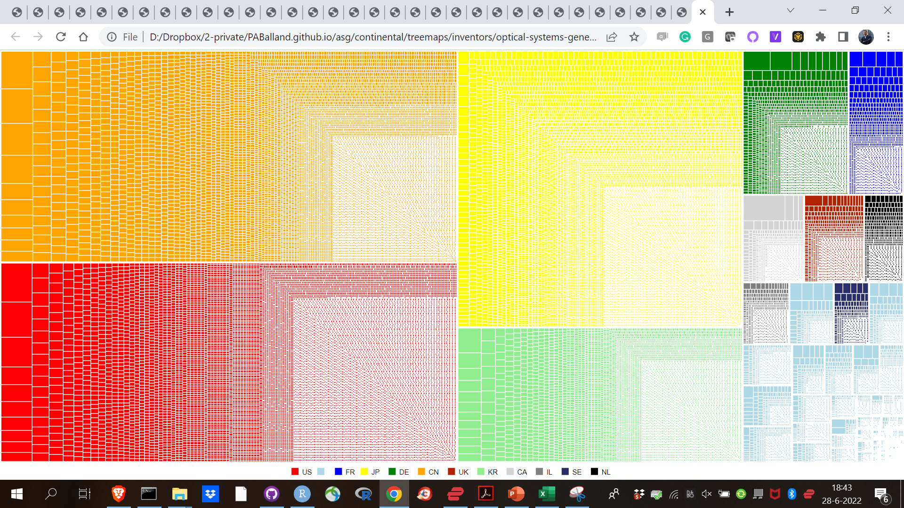
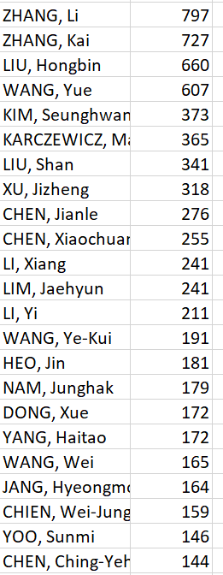
Inventors – Optical systems (general)
65
5

Slide 66
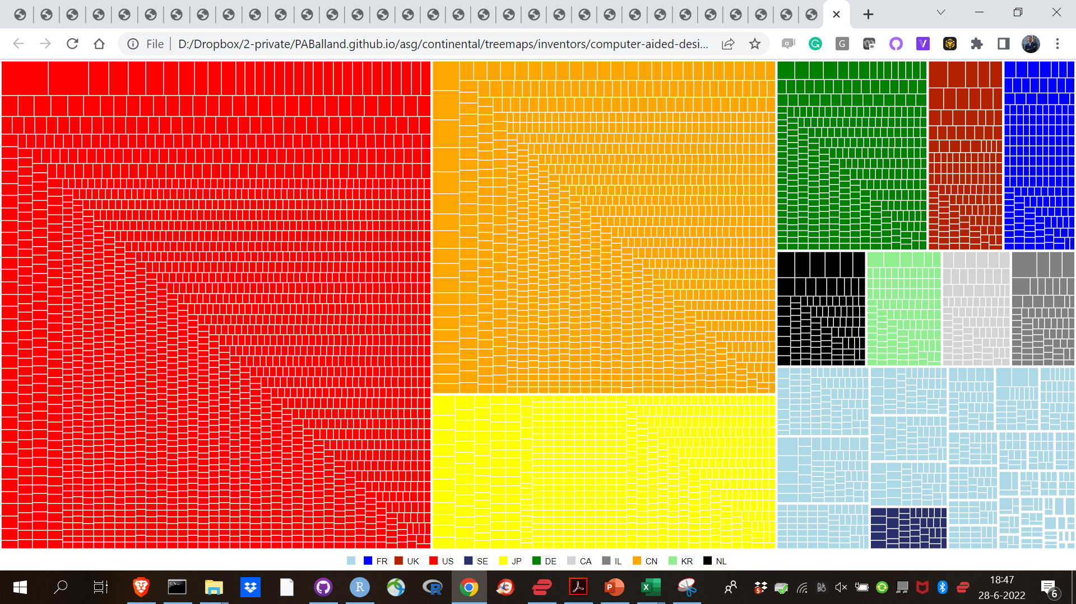
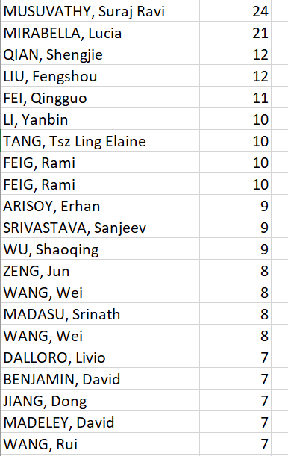
Inventors – CAD
66
5

Slide 67
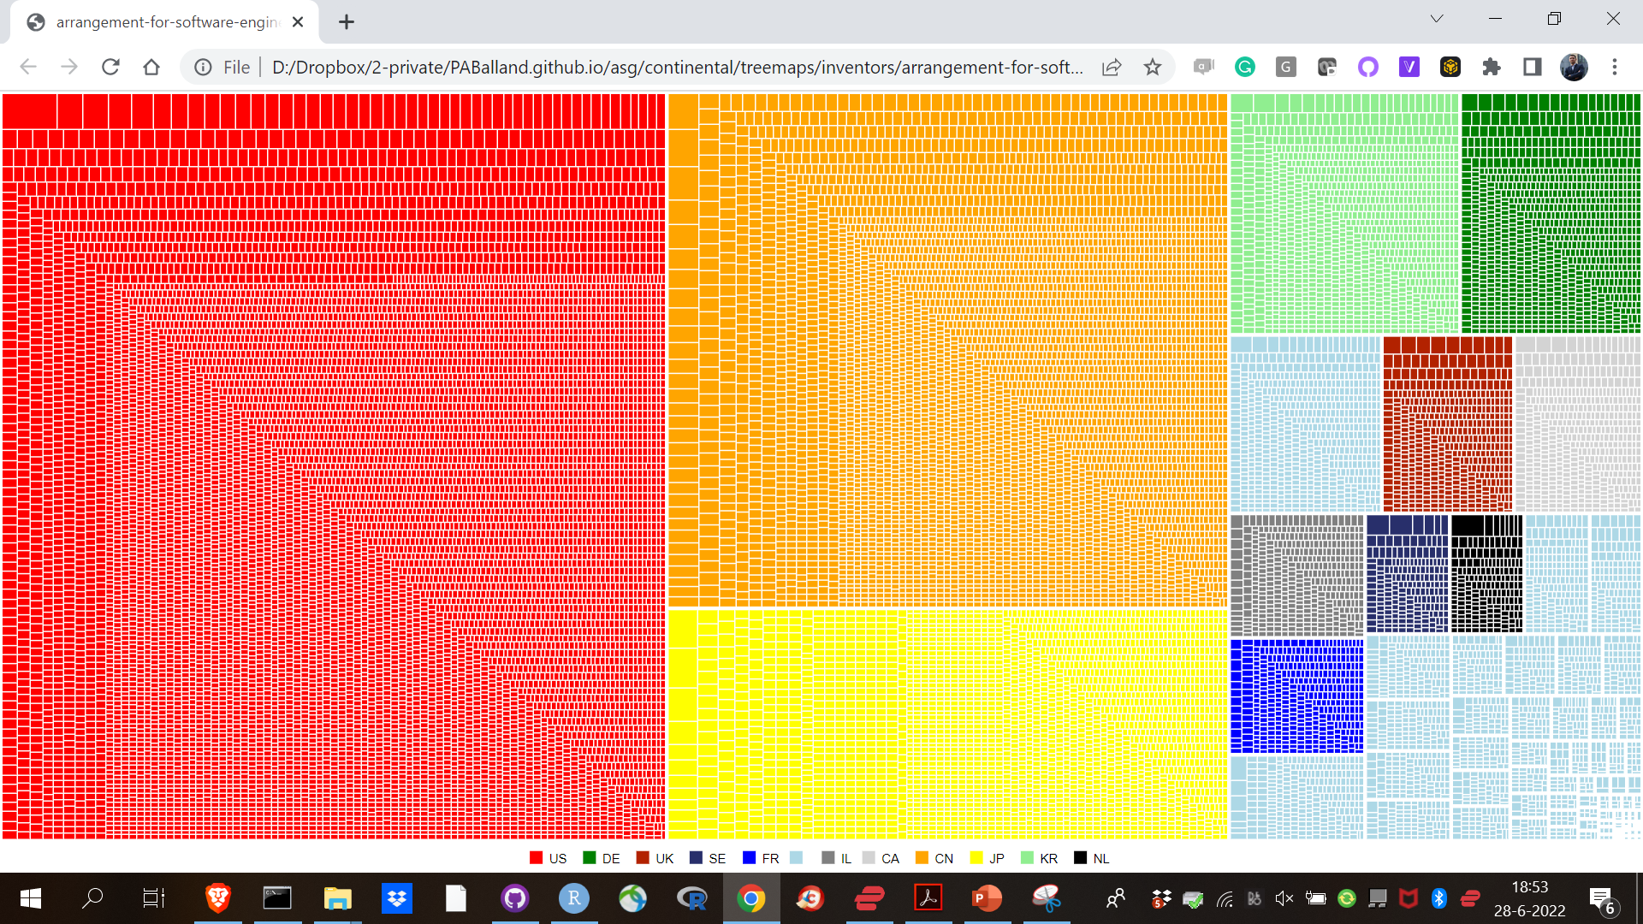
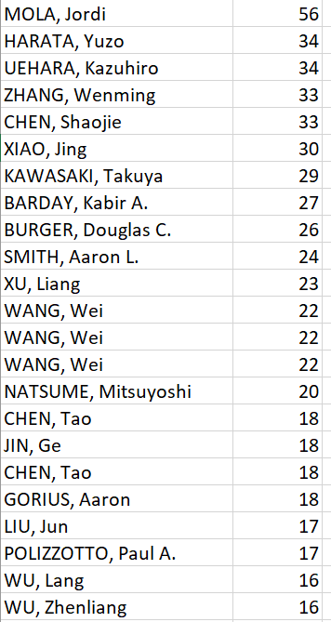
Inventors – Arrangements for SE
67
5

Slide 68
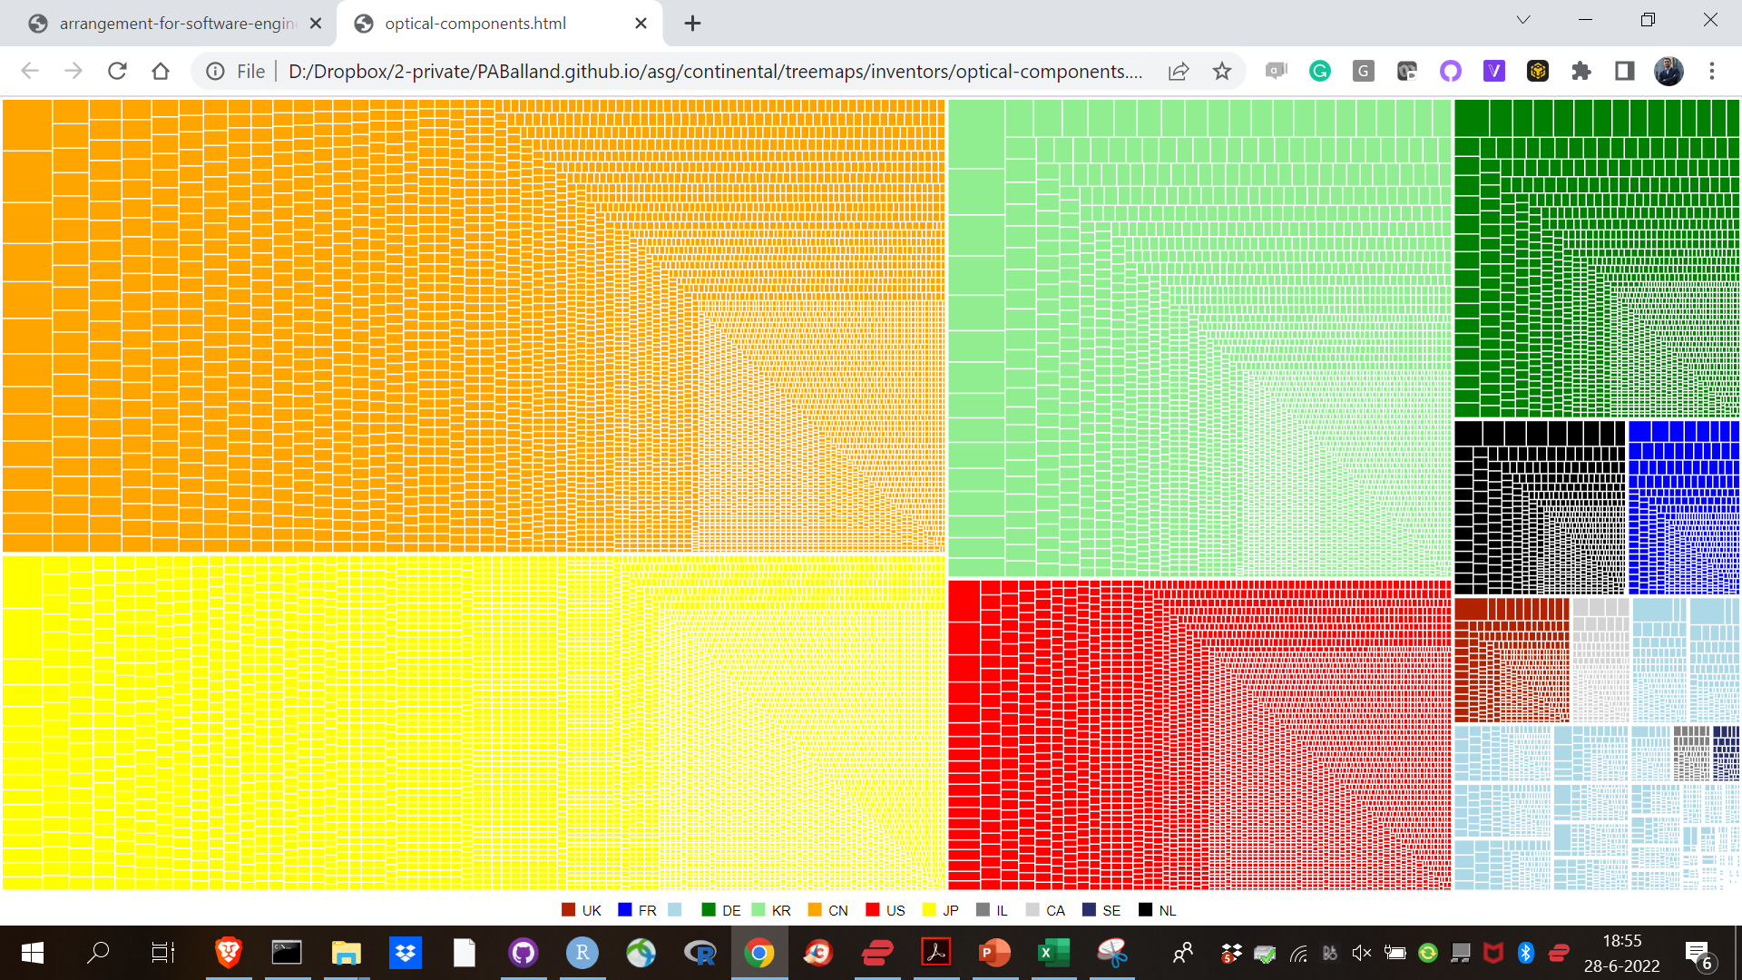
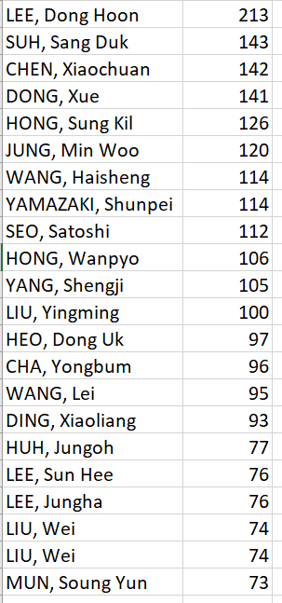
Inventors – Optical components
68
5

Slide 69
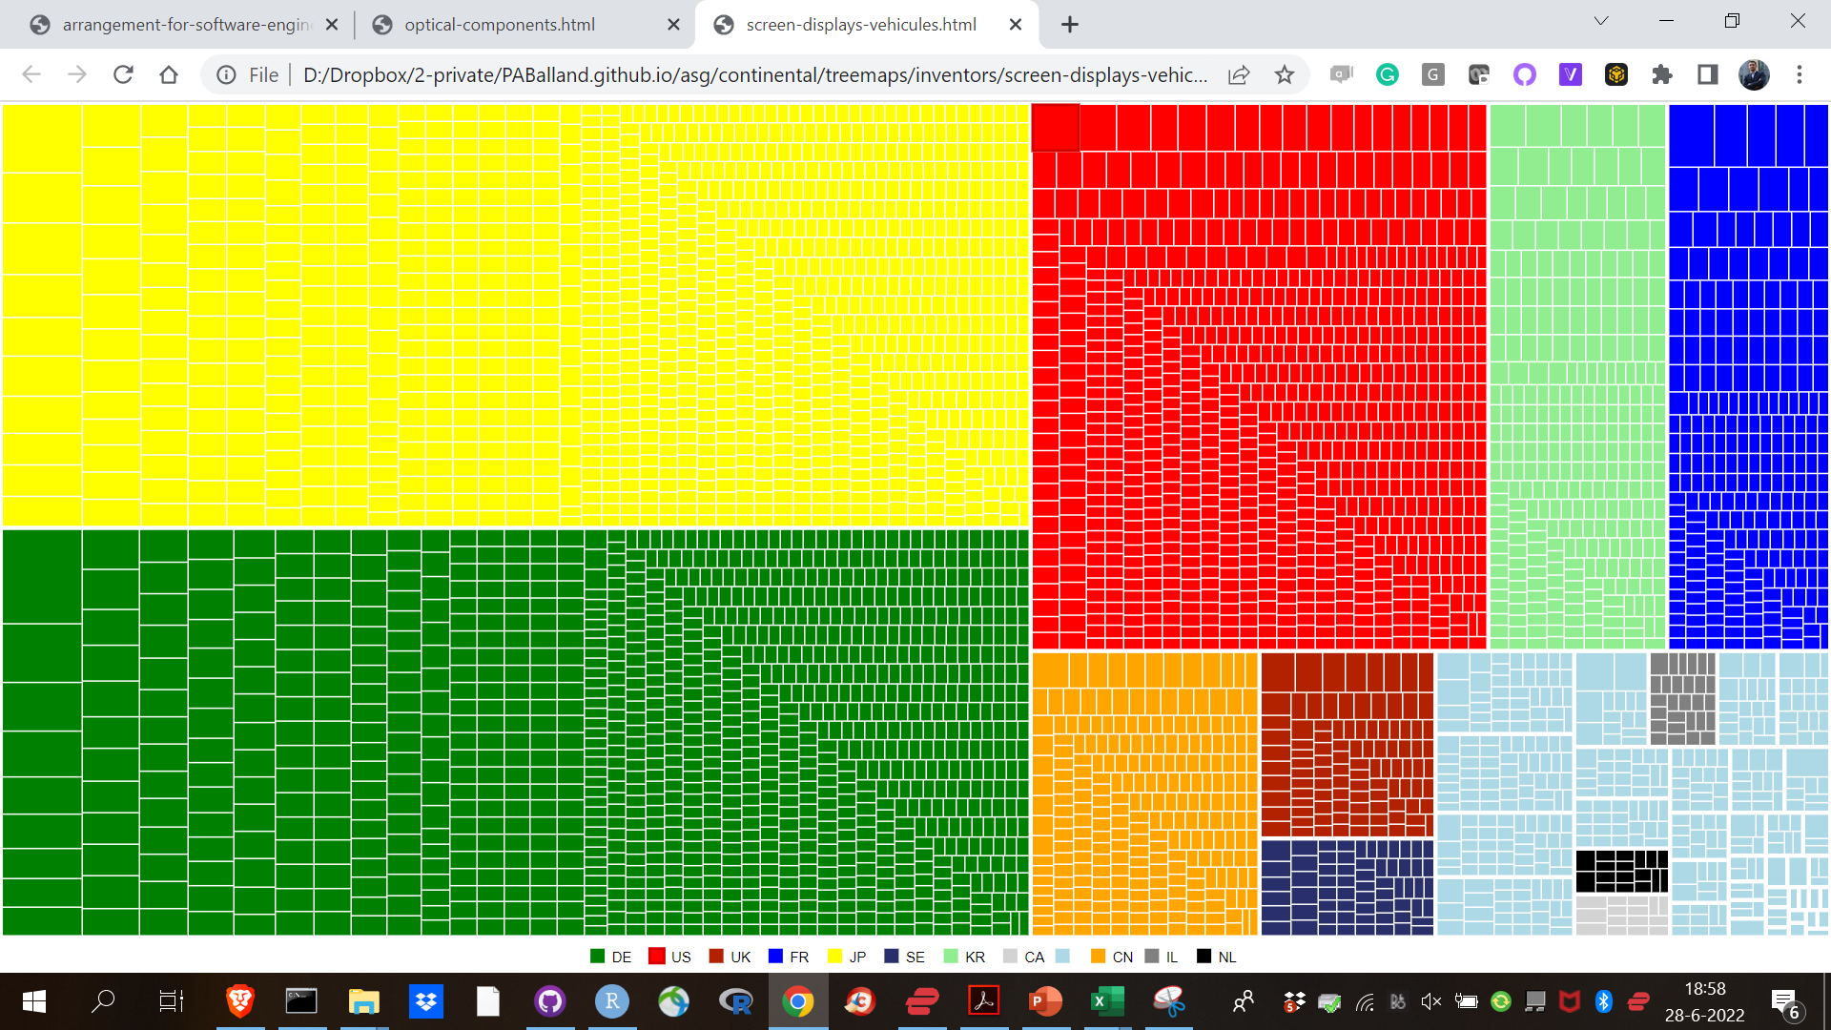
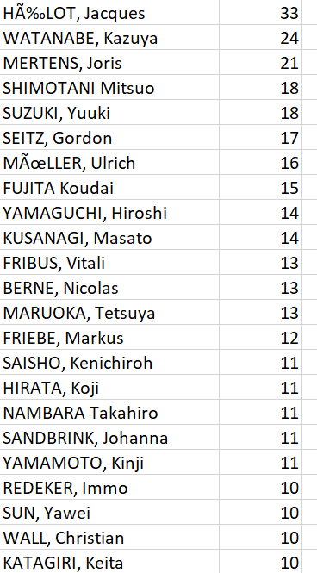
Inventors – Screen displays (vehicules)
69
5

Slide 70
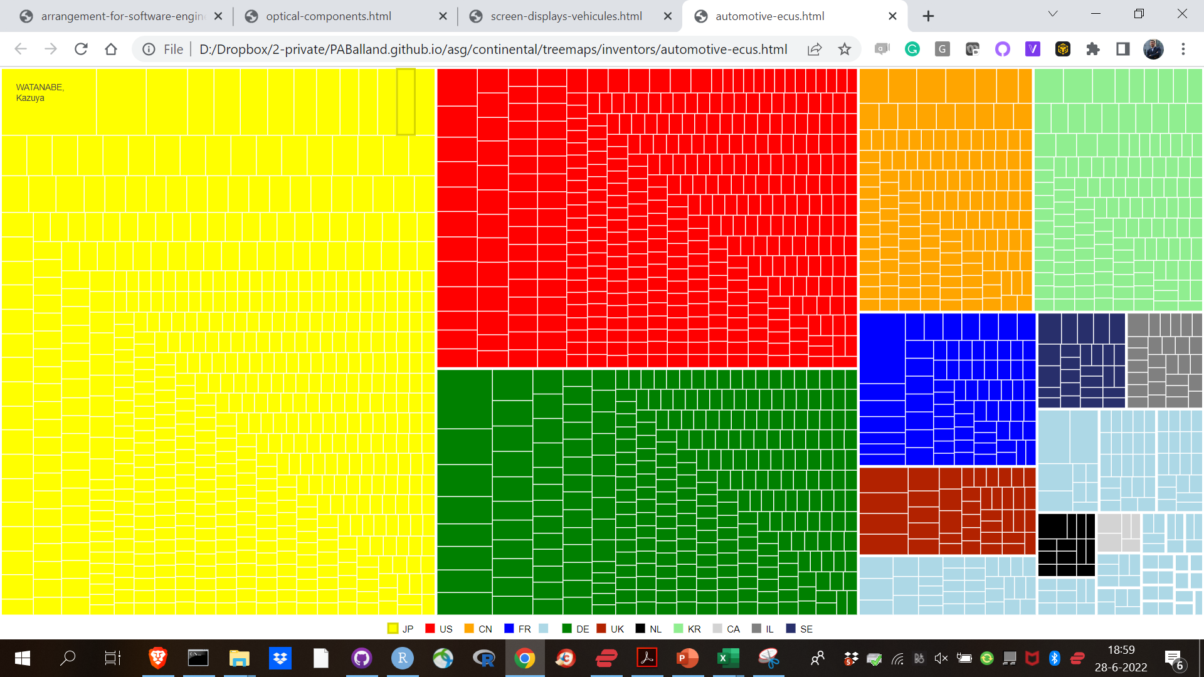
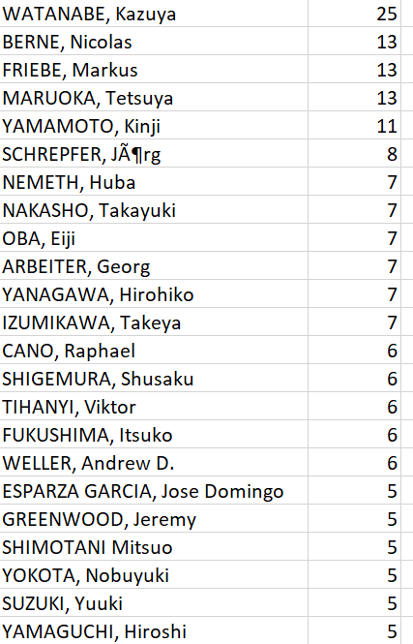
Inventors – Automotive ECUs
70
5

Slide 71
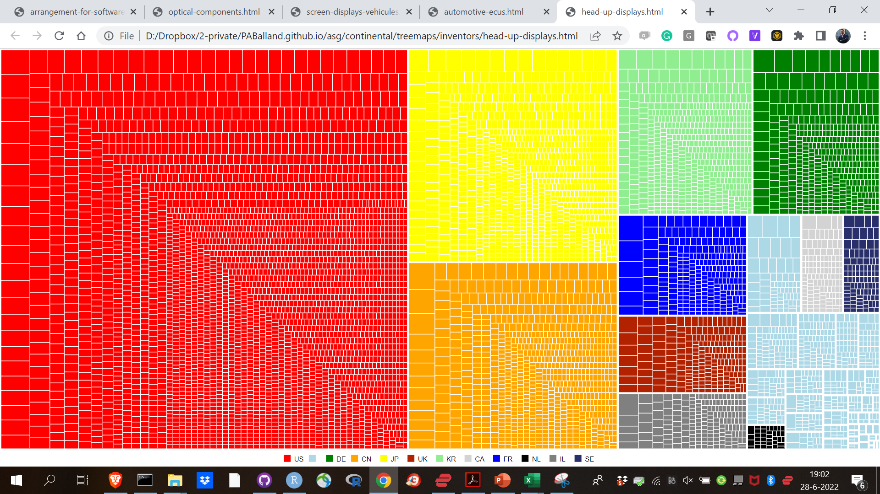
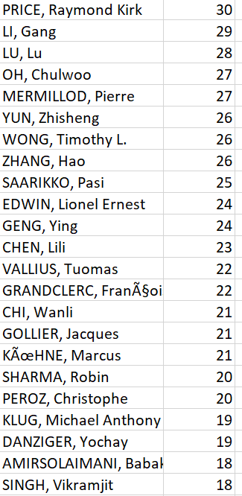
Inventors – HUD
71
5

Slide 72
Key organizations & inventors in urban ecosystems

Slide 73
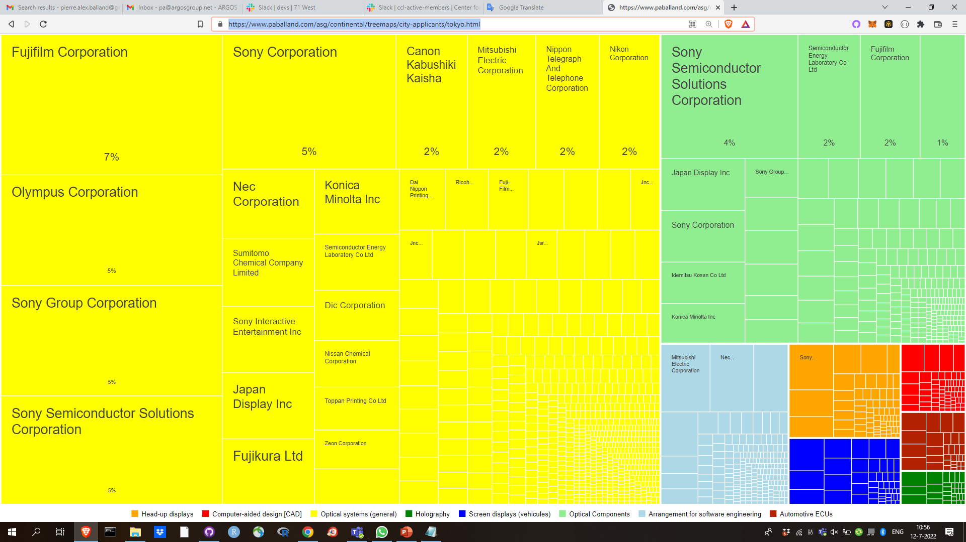
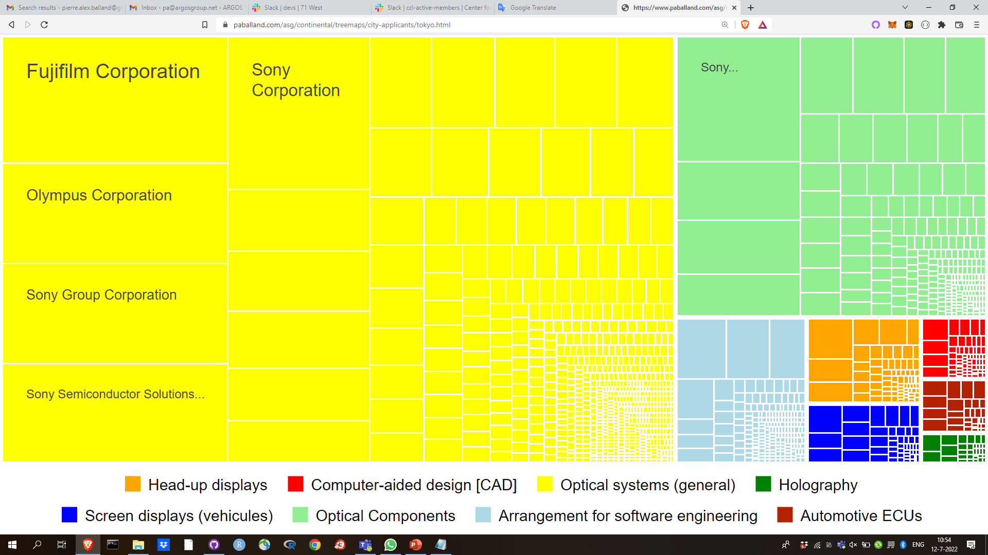
Applicants – Tokyo
71
5

Slide 74

Applicants – Shenzhen
71
5

Slide 75

Applicants – Beijing
71
5

Slide 76

Applicants – Seoul
71
5

Slide 77

Applicants – Wuhan
71
5

Slide 78

Applicants – San José / San Francisco
71
5

Slide 79

Applicants – Los Angeles
71
5

Slide 80

Applicants – Seattle
71
5

Slide 81

Applicants – Boston
71
5

Slide 82

Applicants – New-York
71
5

Slide 83

Applicants – Paris
71
5

Slide 84

Applicants – Munich
71
5

Slide 85

Applicants – Eindhoven
71
5

Slide 86

Applicants – Stuttgart
71
5

Slide 87

Applicants – London
71
5

Slide 88

Inventors – Tokyo
71
5

Slide 89

Inventors – San José / San Francisco
71
5

Slide 90

Inventors – Paris
71
5

Slide 91
Interactive material & data

Slide 92
Technology space & velocity
# TECHNOLOGY SPACE
https://www.paballand.com/asg/continental/tech-space.html
# VELOCITY
https://www.paballand.com/asg/continental/velocity/all.html
https://www.paballand.com/asg/continental/velocity/arrangement-for-software-engineering.html
https://www.paballand.com/asg/continental/velocity/automotive-ecus.html
https://www.paballand.com/asg/continental/velocity/computer-aided-design-[cad].html
https://www.paballand.com/asg/continental/velocity/head-up-displays.html
https://www.paballand.com/asg/continental/velocity/holography.html
https://www.paballand.com/asg/continental/velocity/optical-components.html
https://www.paballand.com/asg/continental/velocity/optical-systems-general.html
https://www.paballand.com/asg/continental/velocity/screen-displays-vehicules.html
73
5

Slide 93
Maps (data & east Asia)
# MAPS (DATA)
https://www.paballand.com/asg/continental/maps/metro.html
# MAPS (EAST-ASIA)
https://www.paballand.com/asg/continental/maps/east-asia/arrangement-for-software-engineering.html
https://www.paballand.com/asg/continental/maps/east-asia/automotive-ecus.html
https://www.paballand.com/asg/continental/maps/east-asia/computer-aided-design-[cad].html
https://www.paballand.com/asg/continental/maps/east-asia/head-up-displays.html
https://www.paballand.com/asg/continental/maps/east-asia/holography.html
https://www.paballand.com/asg/continental/maps/east-asia/optical-components.html
https://www.paballand.com/asg/continental/maps/east-asia/optical-systems-general.html
https://www.paballand.com/asg/continental/maps/east-asia/screen-displays-vehicules.html
74
5

Slide 94
Maps (North America)
# MAPS (NORTH-AMERICA)
https://www.paballand.com/asg/continental/maps/north-america/arrangement-for-software-engineering.html
https://www.paballand.com/asg/continental/maps/north-america/automotive-ecus.html
https://www.paballand.com/asg/continental/maps/north-america/computer-aided-design-[cad].html
https://www.paballand.com/asg/continental/maps/north-america/head-up-displays.html
https://www.paballand.com/asg/continental/maps/north-america/holography.html
https://www.paballand.com/asg/continental/maps/north-america/optical-components.html
https://www.paballand.com/asg/continental/maps/north-america/optical-systems-general.html
https://www.paballand.com/asg/continental/maps/north-america/screen-displays-vehicules.html
75
5

Slide 95
Maps (Europe)
# MAPS (EUROPE)
https://www.paballand.com/asg/continental/maps/europe/arrangement-for-software-engineering.html
https://www.paballand.com/asg/continental/maps/europe/automotive-ecus.html
https://www.paballand.com/asg/continental/maps/europe/computer-aided-design-[cad].html
https://www.paballand.com/asg/continental/maps/europe/head-up-displays.html
https://www.paballand.com/asg/continental/maps/europe/holography.html
https://www.paballand.com/asg/continental/maps/europe/optical-components.html
https://www.paballand.com/asg/continental/maps/europe/optical-systems-general.html
https://www.paballand.com/asg/continental/maps/europe/screen-displays-vehicules.html
76
5

Slide 96
Applicants (treemaps)
# APPLICANTS (HTML FILES)
https://www.paballand.com/asg/continental/treemaps/applicants/arrangement-for-software-engineering.html
https://www.paballand.com/asg/continental/treemaps/applicants/automotive-ecus.html
https://www.paballand.com/asg/continental/treemaps/applicants/computer-aided-design-[cad].html
https://www.paballand.com/asg/continental/treemaps/applicants/head-up-displays.html
https://www.paballand.com/asg/continental/treemaps/applicants/holography.html
https://www.paballand.com/asg/continental/treemaps/applicants/optical-components.html
https://www.paballand.com/asg/continental/treemaps/applicants/optical-systems-general.html
https://www.paballand.com/asg/continental/treemaps/applicants/screen-displays-vehicules.html
77
5

Slide 97
Applicants (data)
# APPLICANTS (CSV FILES)
https://www.paballand.com/asg/continental/treemaps/applicants/arrangement-for-software-engineering.csv
https://www.paballand.com/asg/continental/treemaps/applicants/automotive-ecus.csv
https://www.paballand.com/asg/continental/treemaps/applicants/computer-aided-design-[cad].csv
https://www.paballand.com/asg/continental/treemaps/applicants/head-up-displays.csv
https://www.paballand.com/asg/continental/treemaps/applicants/holography.csv
https://www.paballand.com/asg/continental/treemaps/applicants/optical-components.csv
https://www.paballand.com/asg/continental/treemaps/applicants/optical-systems-general.csv
https://www.paballand.com/asg/continental/treemaps/applicants/screen-displays-vehicules.csv
78
5

Slide 98
Inventors (treemaps)
# INVENTORS (HTML FILES)
https://www.paballand.com/asg/continental/treemaps/inventors/arrangement-for-software-engineering.html
https://www.paballand.com/asg/continental/treemaps/inventors/automotive-ecus.html
https://www.paballand.com/asg/continental/treemaps/inventors/computer-aided-design-[cad].html
https://www.paballand.com/asg/continental/treemaps/inventors/head-up-displays.html
https://www.paballand.com/asg/continental/treemaps/inventors/holography.html
https://www.paballand.com/asg/continental/treemaps/inventors/optical-components.html
https://www.paballand.com/asg/continental/treemaps/inventors/optical-systems-general.html
https://www.paballand.com/asg/continental/treemaps/inventors/screen-displays-vehicules.html
79
5

Slide 99
Inventors (data)
# INVENTORS (CSV FILES)
https://www.paballand.com/asg/continental/treemaps/inventors/arrangement-for-software-engineering.csv
https://www.paballand.com/asg/continental/treemaps/inventors/automotive-ecus.csv
https://www.paballand.com/asg/continental/treemaps/inventors/computer-aided-design-[cad].csv
https://www.paballand.com/asg/continental/treemaps/inventors/head-up-displays.csv
https://www.paballand.com/asg/continental/treemaps/inventors/holography.csv
https://www.paballand.com/asg/continental/treemaps/inventors/optical-components.csv
https://www.paballand.com/asg/continental/treemaps/inventors/optical-systems-general.csv
https://www.paballand.com/asg/continental/treemaps/inventors/screen-displays-vehicules.csv
81
5

Slide 100
Inventors (data)
# INVENTORS (CSV FILES)
https://www.paballand.com/asg/continental/treemaps/inventors/arrangement-for-software-engineering.csv
https://www.paballand.com/asg/continental/treemaps/inventors/automotive-ecus.csv
https://www.paballand.com/asg/continental/treemaps/inventors/computer-aided-design-[cad].csv
https://www.paballand.com/asg/continental/treemaps/inventors/head-up-displays.csv
https://www.paballand.com/asg/continental/treemaps/inventors/holography.csv
https://www.paballand.com/asg/continental/treemaps/inventors/optical-components.csv
https://www.paballand.com/asg/continental/treemaps/inventors/optical-systems-general.csv
https://www.paballand.com/asg/continental/treemaps/inventors/screen-displays-vehicules.csv
81
5

